Slide 1
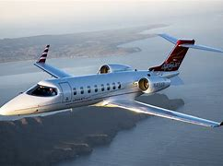
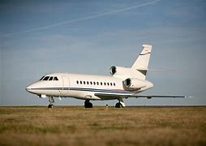
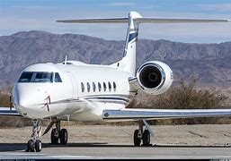
West Star Aviation Apprenticeship Academy: Rethinking the Apprenticeship Model

Slide 2
West Star Aviation Overview
April 2024

Slide 3
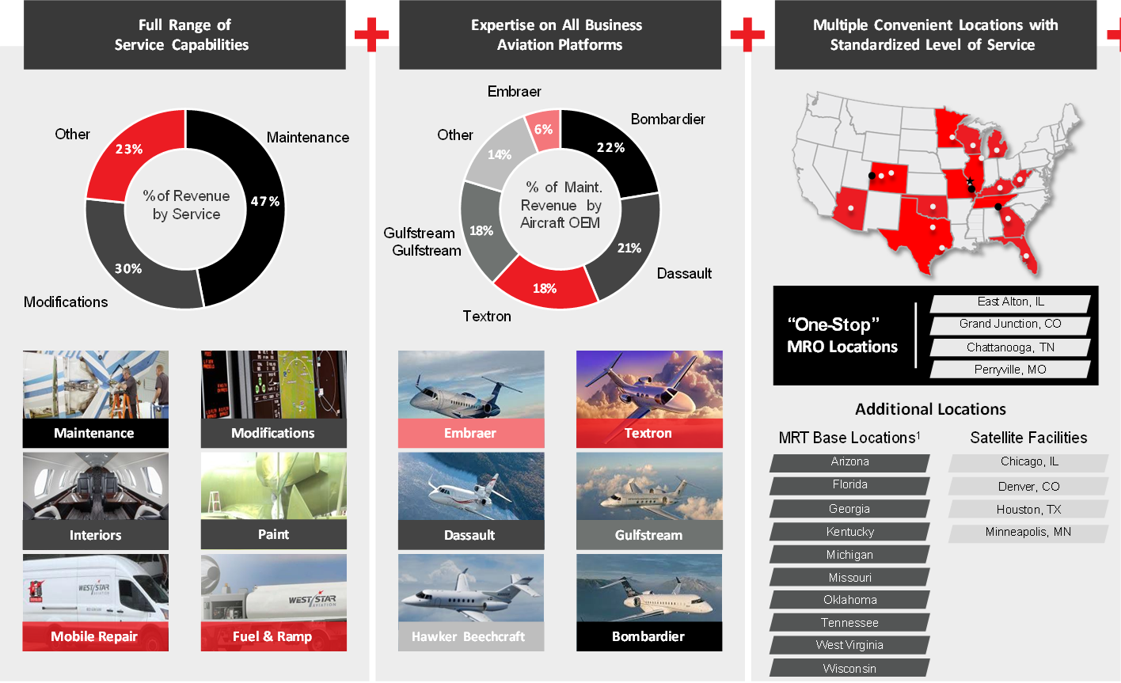
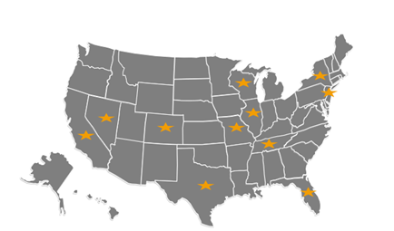
Introduction
FULL SERVICE LOCATIONS
MOBILE TEAMS
SATELLITE LOCATIONS
ALABAMA
ARIZONA
COLORADO
FLORIDA
GEORGIA
ILLINOIS
KENTUCKY
MASSACHUSETTS
MICHIGAN
MISSOURI
OHIO
TENNESSEE
TEXAS
WASHINGTON STATE
WEST VIRGINIA
WISCONSIN
WYOMING
CHICAGO, IL
DENVER, CO
HOUSTON, TX
MINNEAPOLIS, MN
West Palm Beach, FL
SERVICE HUBS
CHICAGO, IL
DALLAS, TX
LAS VEGAS, NV
TETERBORO, NJ
WEST PALM BEACH, FL
WHITE PLAINS ,NY
VAN NUYS, CA

Slide 4
Workforce Overview

Slide 5
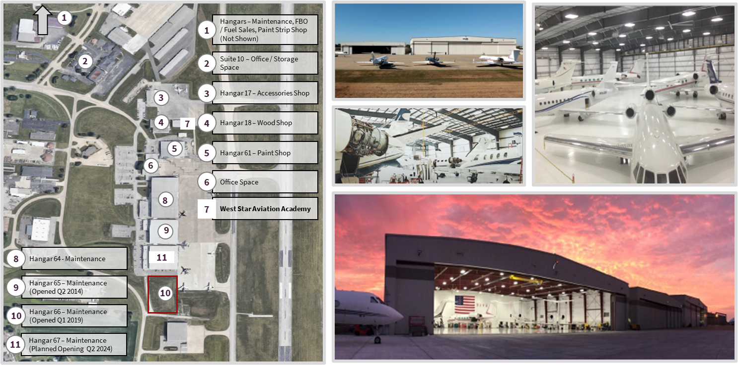
East Alton, Illinois Business Operations ~ 600 Jobs

Slide 6
Workforce Shortage ~ Aircraft Mechanics

Slide 7
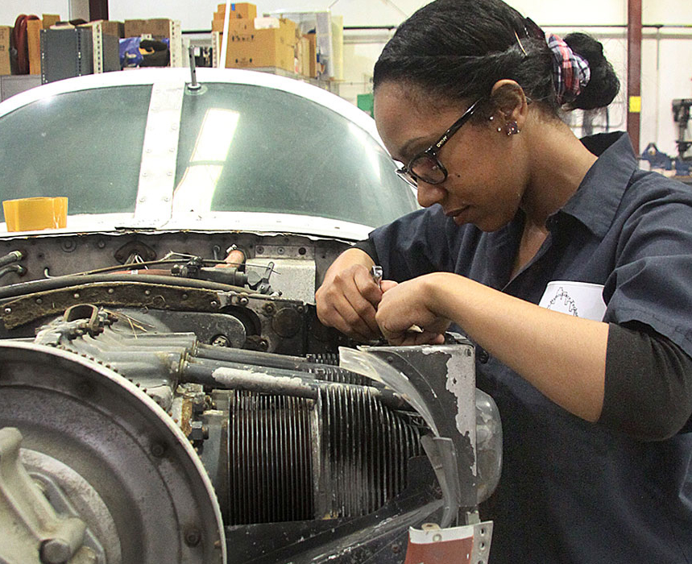
Aviation Maintenance
Southwestern Illinois College is the primary training provider for Aviation Maintenance in the Economic Development Region 9. Program began in 1970 at St. Louis Downtown Airport located in Cahokia Heights, Illinois. Moved to current location in Granite City in 1980.
One of about 200 Airframe and Powerplant (A&P) schools across the United States.
One of only about 10 such A&P schools that offer a one-year certificate format (Five days per week for 50 weeks).
40 credit-hour certificate program in Avionics launched Fall of 2024.

Slide 8
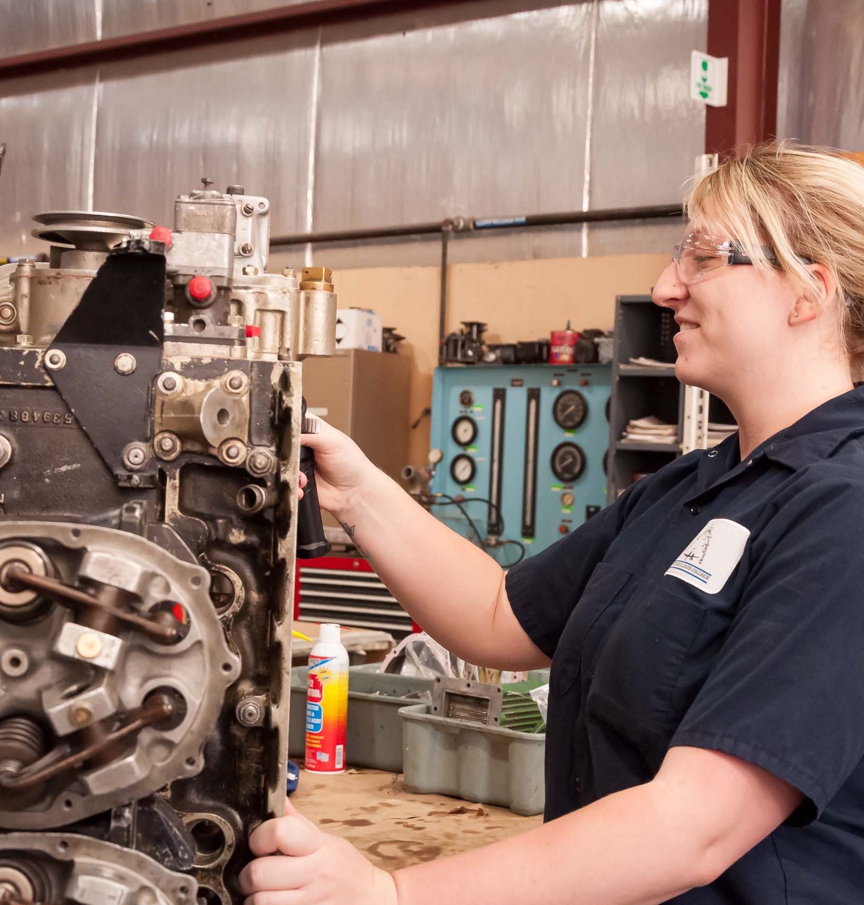
Aviation Maintenance
High-demand, high-wage career, with average wages of $33.88 per hour, more than 700 jobs in the St. Louis metro east region alone, and 75 different employers hiring for Aviation Maintenance occupations.
Airframe and Powerplant Certificates Available in
One- and Two-Year Formats. Degree option also offered.
Current program capacity at Granite City is 50 students. 25 additional students being trained for Airframe certificates at West Star Academy.
Potential expansion ideas include adding classroom at Granite City, starting a 100-week night program, and additional off-campus sites.

Slide 9
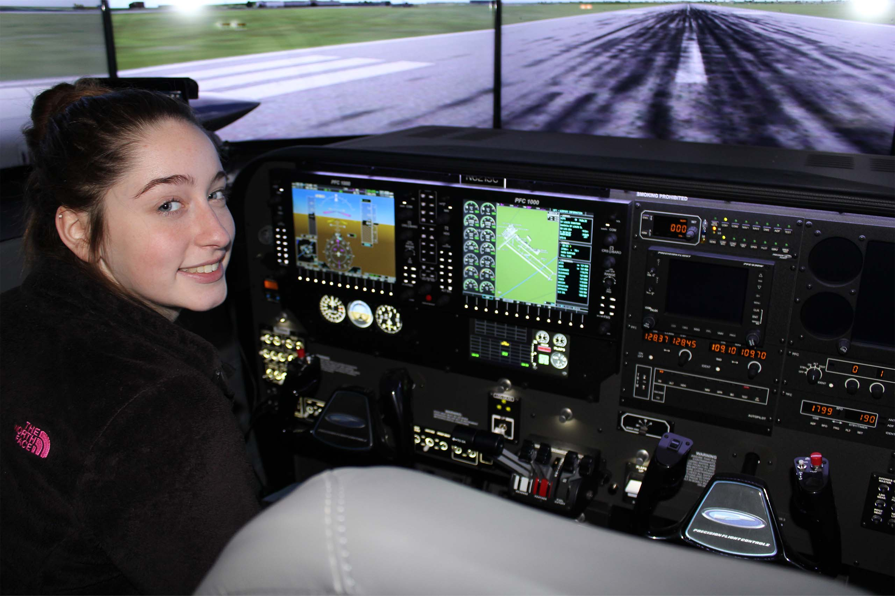
Aviation Management
Management, Dispatch, Airplane and Helicopter Pilot Training
Associate’s Degree plus 23-credit hour
Aircraft Dispatcher Certificate
Aviation Pilot Associate’s Degrees for
Airplane and Helicopter plus Certificates
in Aviation Pilot Training and
Private Pilot Training
Articulates to Bachelor’s
Degree program available in
metro east through Southern
Illinois University-Carbondale

Slide 10
Enabling Jobs Growth
WSAA will accelerate our longstanding Apprenticeship program to create a stronger funnel of work-ready and licensed AMTs through an increased focus on education, practical and proprietary training.
Apprentices will receive full pay and benefits during the 7.5 month learning and training period. After obtaining their Airframe license they will start working in our hangars alongside a Senior AMT.
Key success factors include designating a learning hangar on West Star’s campus, partnering with Southwestern Illinois College (SWIC) an FAA approved Part 147 educator and leveraging the Choose Aerospace curriculum.
West Star’s ongoing commitment to mentoring new AMTs will be integrated into WSAA, enabling Apprentices to connect with their mentors and participate in job shadowing when school is not in session, underscoring our commitment to their readiness for work and team integration.
Apprentices will agree to a retention period while enjoying ongoing growth at West Star. Graduates from WSAA will be able to step-progress as an AMT as their skills grow and participate in programs like Emerging Leader to prepare for leadership and other career enhancing opportunities.

Slide 11
High School to Work Opportunities
Industry demand for licensed AMTs surpasses the availability of qualified people to fill jobs. Choose Aerospace, in partnership with AOPA, are pioneering the way to introduce Aviation content in high schools across the US. Increased awareness to Aviation careers with educational content that creates a direct pathway and more readiness for college or work.
Future hires who completed Choose Aerospace in high school will reduce 10 weeks of learning in WSAA which strengthens our ability to encourage educators to adopt the curriculum.
Choose Aerospace was developed by Clemson University in partnership with ARCS Aviation, Aviation Technician Education Council and the FAA to include approximately 500 hours of content covering the general subject areas in the recently revised FAA Mechanic Airman Certification Standards (same requirements under part 147).
The curriculum is designed for community-based deployment in high schools without being recognized as a part 147 educator, having a hangar, tools etc.
Limited equipment, materials and teacher qualifications are required with Aviation Technician Education Council providing “teacher bootcamp” to ensure readiness, educator aids, pacing etc.

Slide 12
West Star Academy
Public-private partnership at work.
25 Apprentices trained for Federal Aviation Administration Airframe Licensure at approximately $8,000 each in training costs.
Illinois Job Training and Economic Development (JTED) grant coordinated by Department of Commerce and Economic Opportunity offset $7,000 per participant costs for first cohort.
Second cohort currently underway. Employer risk tolerance increased thanks to public subsidy helping prove concept in first round of training.

Slide 13
Service Integration
Program success relies on leveraging complementary resources from local, state, and federal organizations.
Flexibility from Illinois DCEO allowed grant modification that made West Star Aviation Academy possible.
Sharing of information and resources between Local Workforce Areas, area businesses and employers, and training providers
Culture of Collaboration in EDR 9 benefits workforce and economic development across Southwestern Illinois

Slide 14
Local Workforce Area (LWIA 22)
West Star
Apprenticeship Academy:
Create OJT Contract with West Star
Provide OJT Reimbursements
3 of 25 participants eligible for OJT reimbursements in first class
5 of 25 participants eligible for OJT reimbursements in current class
14

Slide 15
Local Workforce Area (LWIA 22)
West Star – Madison County Employment & Training:
Provide OJT Reimbursement for apprentices in traditional apprenticeship program
High School Student with a Disability Apprenticeship Program
Incumbent Worker Training for West Star Staff
15

Slide 16
Apprenticeship Accelerator
Funded through Illinois Department of Commerce and Economic Opportunity’s Job Training and Economic Development (JTED) Program.
Financial Incentives provided to employers who utilized Registered Apprenticeship as a
Workforce Development Tool
Southwestern Illinois College is a registered intermediary with the US Department of Labor in 18 occupations
Barrier Reduction Funding utilized
to support persistence,
retention, and completion

