Slide 1
Youth Apprenticeships and TPM - Strategies in health care -
High School District 214 Youth Apprenticeship Model
Lazaro Lopez, Ed.D | Associate Superintendent for Teaching and Learning
Marcella M. Reca Zipp, Ed.D. | Director of Grants and Special Program
Barb Kain | Director for Career Discovery
Kathy Gannon | Partnership Manager / Apprenticeship Program Supervisor
Notes:
Laz

Slide 2
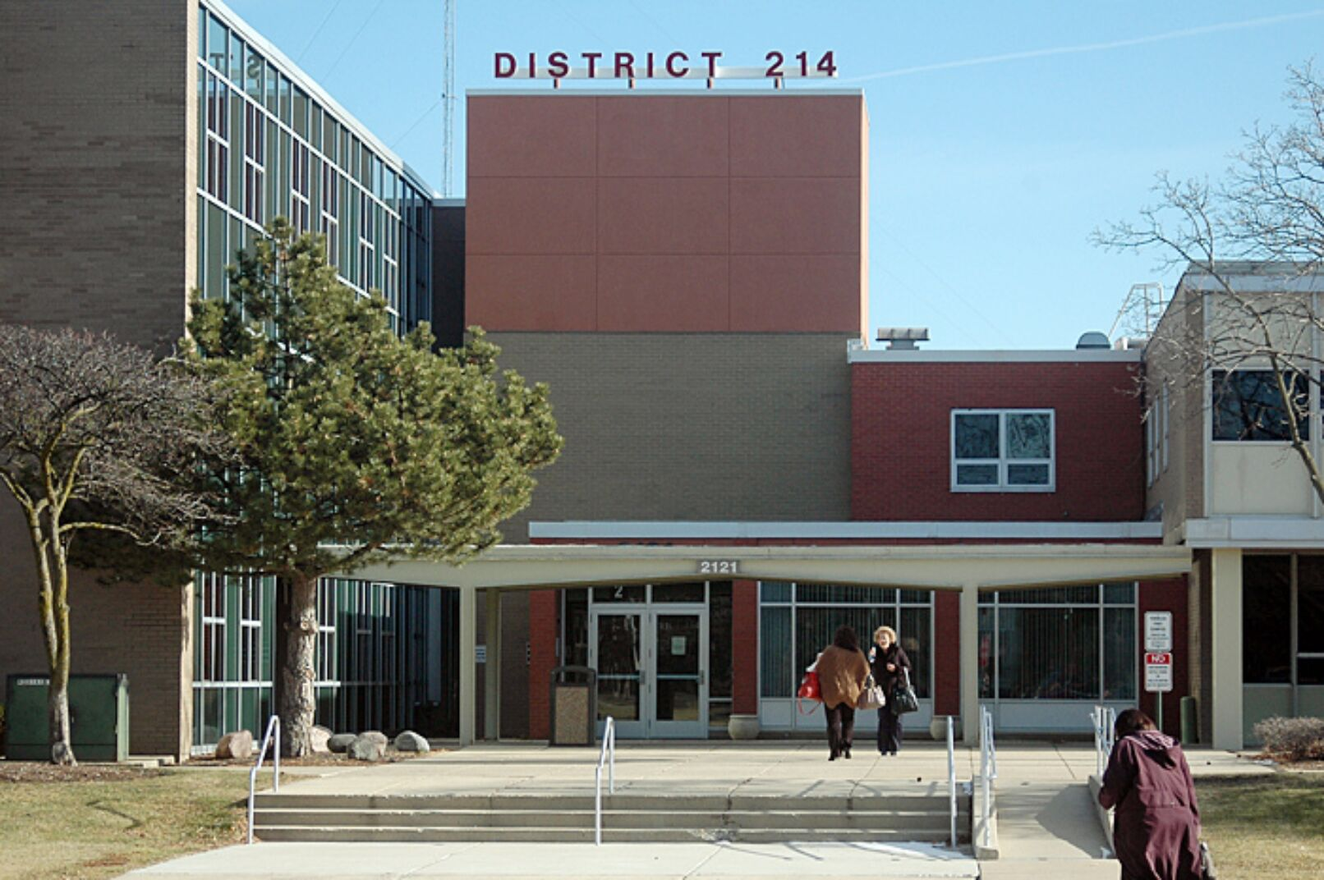
12,000 STUDENTS
6 COMPREHENSIVE HIGH SCHOOLS AND 1 SPECIALIZED CAMPUS WITH 3 SCHOOLS
Who we are...
1570 STAFF MEMBERS
16 NATIONALLY RECOGNIZED CAREER CLUSTERS
Notes:
Laz: Background on D214: high school district with 7 different high schools, roughly 12,000 students

Slide 3
44 CAREER
PROGRAMS OF STUDY
1000+ INDUSTRY PARTNERS
Who we are...
2500+ WORK-BASED LEARNING EXPERIENCES
85% GRADUATES EARN EARLY COLLEGE CREDITS
Notes:
Laz: Background on D214: strong focus on offering student opportunities to participate in career focused coursework and work-based learning experiences as well as participating in early college credit coursework, many of which also offer industry credentials and cerfifications

Slide 4
Today’s purpose
To discuss how District 214 engages with business partners to facilitate youth apprenticeships as a tool for pipeline development in healthcare.
Notes:
Laz: Focus for today is how we worked with industry partners, specifically in the healthcare field, to create an apprenticeship program that serves as tool for pipeline development

Slide 5
Career Pathways
GUIDING PRINCIPLES
1
2
3
Sequence of courses that leads beyond high school
Embedded work-based learning through PBL, industry partner engagement, and Tier 1 career experiences
Opportunities to earn strategic early college credit and/or attain an industry credential
‹#›
Notes:
Barb: At D214, our career pathways programming is built around 3 principles: each pathway offers students a sequence of courses with options for on and off-ramps, the opportunity to participate in WBL in authentic industry settings, and the chance to take early college credit-bearing coursework and earn industry certifications. We are meeting principles 1 & 3 through the healthcare pathway coursework we offer – specifically the CNA certification course taken by juniors and seniors.

Slide 6
Healthcare Course Options
Notes:
Barb: Here’s a look at the coursework we offer students in our healthcare pathway, including the CNA certification course taken by juniors and seniors. To be ready to be an apprentice senior year, students really have to start the pathway as freshman with Intro to Health Care.

Slide 7
Career Pathways
GUIDING PRINCIPLES
1
2
3
Sequence of courses that leads beyond high school
Embedded work-based learning through PBL, industry partner engagement, and Tier 1 career experiences
Opportunities to earn strategic early college credit and/or attain an industry credential
‹#›
Notes:
Barb: to provide a robust pathways experience, we have to go beyond the classroom to offer students the opportunity to participate in WBL. We offer all students opportunities for participate in WBL – from supported work environments for students with special needs to independent internship and apprenticeship experiences. We’re specifically going to talk about the healthcare apprenticeship program today, and the process from inception through robust pipeline development and management.

Slide 8
01
Organize for employer leadership & collaboration
strategy
Notes:
Kathy: the first strategy for developing a robust talent pipeline is the collaboration between parties to create a program (in our case apprenticeship) that will funnel talent to the employer. The benefit we bring to employers is that we are the educational provider and we cover the cost and serve as the intermediary

Slide 9
Engage with healthcare providers
Notes:
Kathy: tell the story about how when we initially approached healthcare employers to propose the development of an apprenticeship program, most providers were hesitant to engage because they were concerned about employing students under the age of 18. Working now in a “collaborative” to come together to plan and gain traction.

Slide 10
02
Project critical job demand
strategy
Notes:
Kathy: Key to convincing employer partners to engage with the District is demonstrating that we understand their pipeline needs and have a way of working together to fulfill them

Slide 11
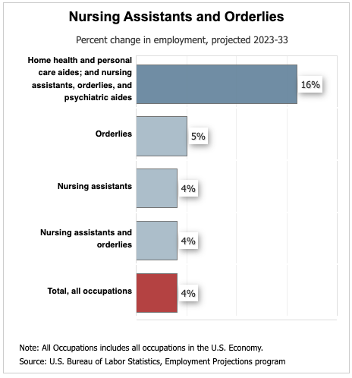
Covid was the tipping point that really opened pipeline conversations
February 2020
According to the U.S. Bureau of Labor Statistics, approximately 420,000 nursing home employees, many of whom were CNAs, left the workforce since February 2020.
Notes:
Kathy: What finally got them to start engaging with us? Two things: 1. The success stories we shared about our initial CNA apprenticeship experience with a single partner (GA) and 2. COVID - with nursing assistants leaving the healthcare industry in droves, employers were open to new avenues for pipeline development

Slide 12
03
Align and communicate job requirements
strategy
Notes:
Kathy

Slide 13
Aligning job requirements
Cna certification
Industry job descriptions
DOL registered cna apprenticeship competencies
Notes:
Kathy: once we had a “seat at the table,” it was important to have a conversation with employers about what skills they’re looking for in CNAs and then be able to 1) demonstrate that D214 students appropriately skilled through their coursework, clinicals and certification exam as CNAs, and 2) develop a list of competencies that these student apprentices would work toward that align with the job responsibilities the employer is seeking to fulfill. We were lucky that a competency framework already existed for a DOL registered CNA apprenticeship so we were able to utilize that. Students have already done 350 hours of RTI, Math, English Proficient and Clinicals prior to the apprenticeship- 800 hours over the course of Freshman-Junior Year. This is a 4 year experience with the capstone as a senior

Slide 14
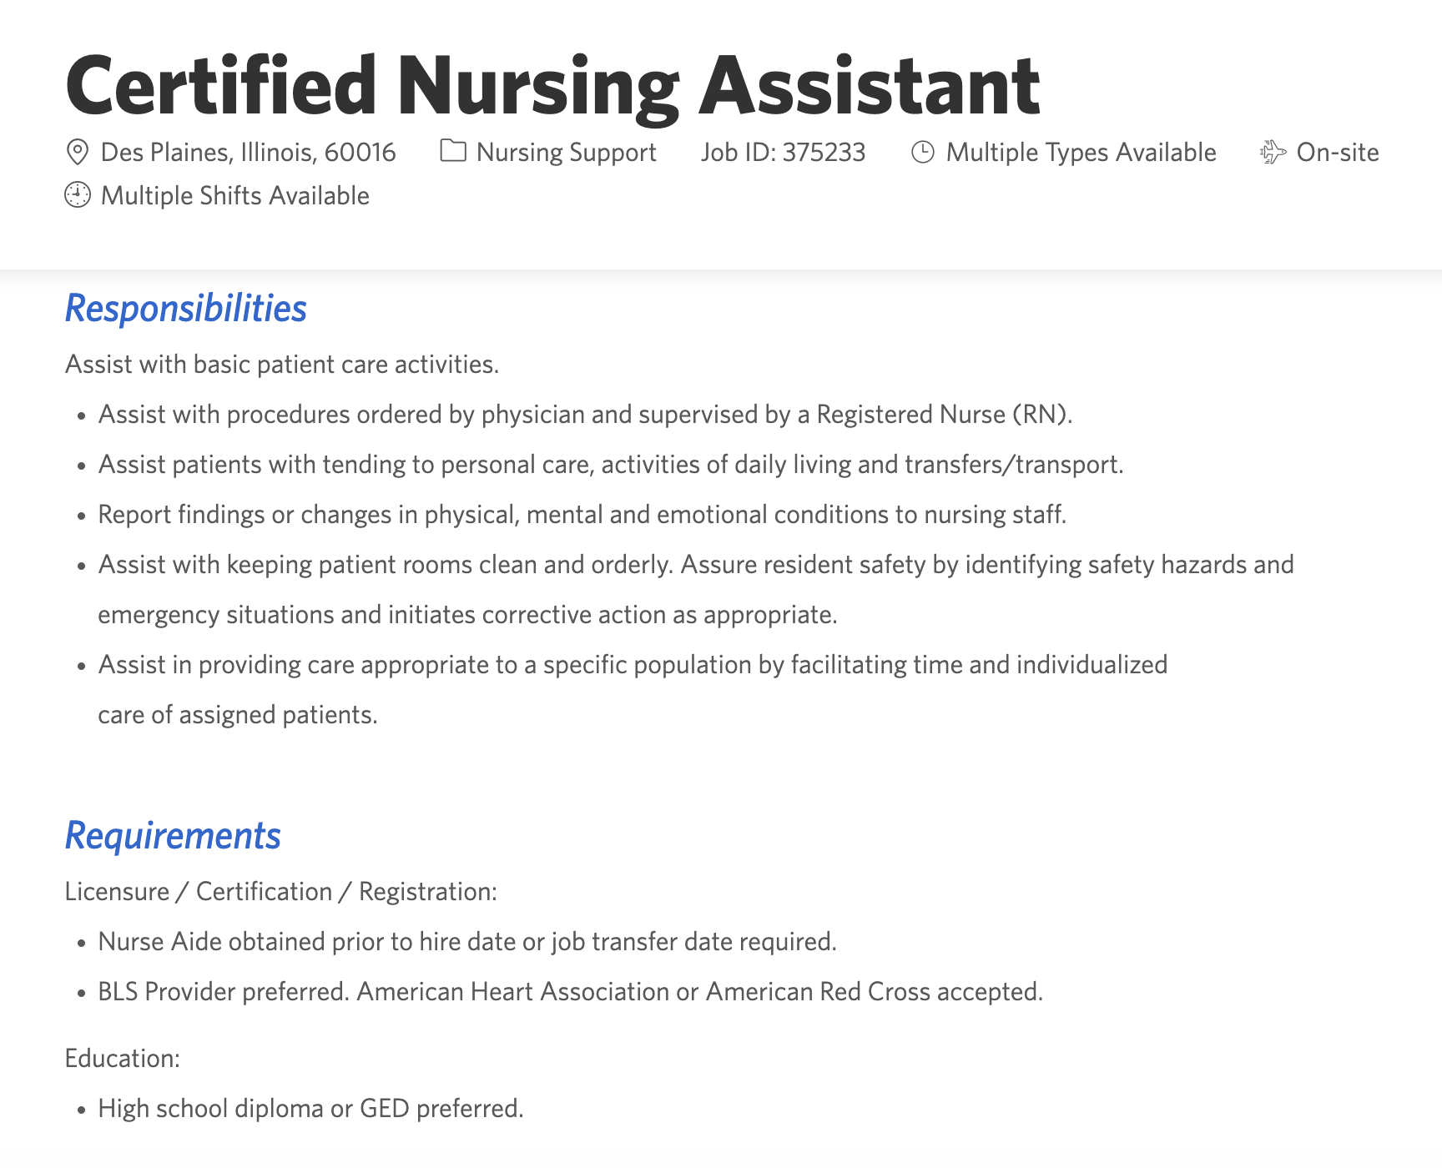
Knowledge
Skills & Abilities
Certifications
Notes:
Kathy: were able to match the skills identified in the competency framework to the requirements employers were looking for

Slide 15
Align student schedules to meet employer need
BLOCK | A DAY | BLOCK | B DAY
1 | Dual Credit English | 5 | Apprenticeship Work Time
2 | Dual Credit Math | 6 | Apprenticeship Work Time
3 | Related Technical Instruction Dual Credit: College Anatomy Lunch | 7 | Apprenticeship Work Time Lunch
4 | Related Technical Instruction Dual Credit: College Physiology | 8 | Apprenticeship Work Time
Academics and employment are built into the student schedule
‹#›
Notes:
Kathy: and we work with the employers to understand their scheduling needs and customize students’ schedules to meet those needs

Slide 16
04
Analyze talent supply
strategy

Slide 17
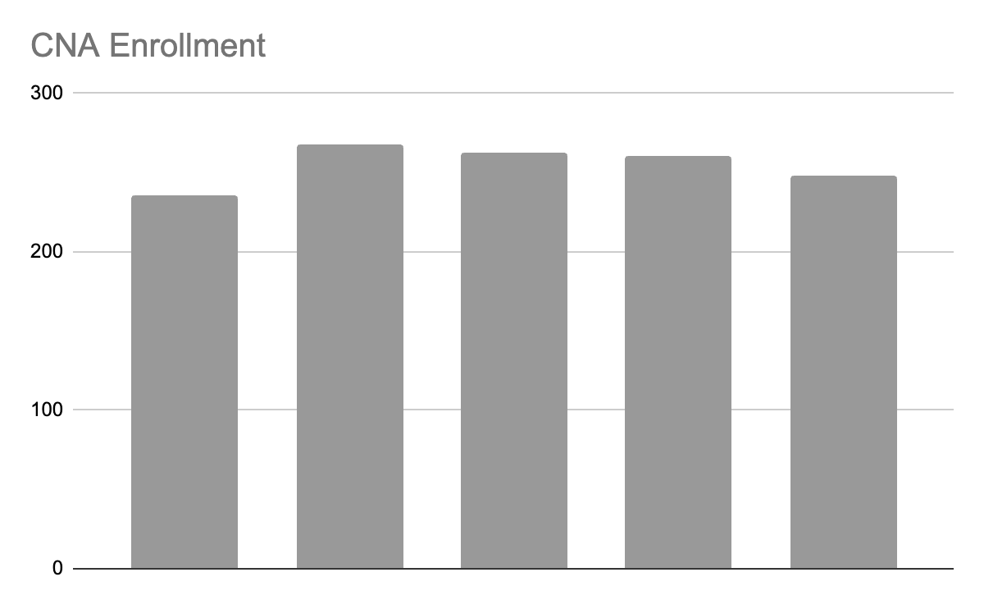
District 214 CNA Course ENrollment
Notes:
Over the last 5 school years we have averaged 255 students completing the CNA course and certification annually. In our area, other school districts that access the CNA course through partnership with our local community college are enrolling similarly robust class sizes.

Slide 18
Collaborate on a strategy to recruit students…
Develop a recruitment strategy
Promote the apprenticeship opportunity
Visit career pathway classrooms
Participate in course selection
One-on-one appointments with students
Counselor referrals
Teacher referrals
Screen and interview potential apprentices
Internal interview (Program Supervisor, Student Success Coach, Counselor)
Employer interview
‹#›
Notes:
Having a robust pool of qualified student CNAs is important, but we then have to motivate the juniors to participate in a CNA apprenticeship their senior year, so a recruitment strategy is developed that includes several different touchpoints with students, such as visits to their CNA classrooms, information sessions for both students and parents, one-on-one appointments and referrals from counselors or teachers. We then employ a robust application and screening process to identify candidates to participate in interviews with both a D214 interview team and an employer interview team.

Slide 19
05
Build talent supply chains
strategy
Notes:
Building a talent supply chain is dependent upon successful experiences for our student apprentices, from both the employer and student employee standpoint.

Slide 20
Develop a collaborative onboarding plan (district & employer)
Employer Admin Team Onboarding: site visit, background check, partner agreement, program details & logistics, resources
D214 Student Onboarding: Workplace readiness
Employer Onboarding:
New employee onboarding (HR, payroll, etc.)
Job-specific training
Resources for success
Student Success Coach
Program Supervisor
‹#›
Notes:
To facilitate the start of a successful experience, both the District and the employer need to be willing to invest in the appropriate training and preparation.

Slide 21
Ongoing Support for the student apprentices
From the employer:
Designated mentor and/or supervisor
Mechanism for regular feedback and support
Collaborative performance check-ins (employer + apprentice + D214)
Networking opportunities
From D214:
Monthly + check-ins w/Student Success Coach (review hours log, progress against competencies, problem solving, etc.)
Collaborative performance check-ins (employer + apprentice + D214)
Notes:
And once onboarded and working, an ongoing system of support must be provided to students both at the employer site and in their school buildings

Slide 22
06
Engage in continuous improvement and resiliency planning
strategy
Notes:
To ensure satisfactory performance, a plan for continuous feedback and improvement needs to implemented with fidelity. Our hope is to continue to see students who graduate from our program and maintain their employment, whether that’s working while in school or home for school breaks, or transitioning directly into the workforce.

Slide 23
Continuous improvement through ONGOING supports for the employer
Monthly check-ins with program supervisor to review apprentice progress
Ongoing assessment of apprentices’ skill development and identification of gaps and additional opportunities
Constructive feedback from apprentice check-ins
Assessing the impact of the apprenticeship on business outcomes; being flexible to adjust as needed
Notes:
In addition to providing supports for the student employees, it’s important that the District and employer connect regularly to review student progress, assess skill development, identify any learning gaps and be flexible about making adjustments based on both student and employer needs

Slide 24
Collaborate to ensure program requirements are being met and accurately reported
Ensure the apprenticeship program meets regulatory standards (e.g., minimum wage, working hours, safety).
Submit required documentation and reports to relevant apprenticeship agencies or funding bodies.
Maintain student records with required documentation.
Track and report apprentice progress to relevant stakeholders.
Keep up-to-date with changes in apprenticeship funding, policies, and best practices.
Notes:
It’s also important that the apprenticeship program remains in compliance with any requirements to guarantee continued grant funding and to ensure compliance with DOL requirements

Slide 25
Example
D214 Apprentices By Cohort and Occupation
Occupation | 19-20 | 20-21 | 21-22 | 22-23 | 23-24 | 24-25 | Total
Athletic Trainer Assistant |  |  | 2 | 5 | 5 | 1 | 13
Automobile Body Repairer |  |  |  |  |  | 1 | 1
Automotive | 1 | 2 | 1 | 1 | 3 | 3 | 11
Certified Nursing Assistant |  | 1 | 1 | 6 | 3 | 5 | 16
Construction/Trades |  | 1 | 2 | 3 | 3 | 3 | 12
CyberSecurity | 2 | 3 | 1 | 2 |  |  | 8
Early Childhood Education |  |  |  |  | 6 | 6 | 12
Graphic Arts |  |  | 1 | 1 | 3 | 3 | 8
HVAC | 1 |  |  |  |  | 1 | 2
IT Generalist |  |  | 3 | 2 | 1 | 1 | 7
Legal Assistant |  |  |  |  |  | 2 | 2
Manufacturing |  |  | 7 |  | 4 | 4 | 15
Multimedia |  |  | 1 | 1 | 3 | 1 | 6
Pharmacy Technician |  |  | 1 | 1 | 8 | 5 | 15
Professional Cook |  |  |  | 1 |  | 2 | 3
Veterinary Assistant |  |  |  | 2 | 2 | 2 | 6
Grand Total | 4 | 7 | 20 | 25 | 41 | 40 | 137
Notes:
Marcella

Slide 26
Occupation By Gender
Occupation | F | M | Total
Athletic Trainer Assistant | 9 | 4 | 13
Automobile Body Repairer | -- | 1 | 1
Automotive | -- | 10 | 10
Certified Nursing Assistant | 14 | 2 | 16
Construction/Trades | 2 | 10 | 12
IT Cyber Security | 1 | 8 | 9
Early Childhood Education | 12 |  | 12
Graphic Arts | 6 | 2 | 8
HVAC | -- | 2 | 2
IT Generalist | 1 | 6 | 7
Legal Assistant | 1 | 1 | 2
Manufacturing | 2 | 13 | 15
Multimedia | 4 | 2 | 6
Pharmacy Technician | 14 | 1 | 15
Professional Cook | 1 | -- | 1
Veterinary Assistant | 4 | 2 | 6
Water Operator | -- | 2 | 2
Grand Total | 71 | 66 | 137
Example
D214 Apprentices By Student Group
Student Group | Number | Percent
Low Income | 44 | 32.12%
IEP/504 | 27 | 17.12%
English Learner | 11 | 8.03%
D214 Apprentices By Ethnicity
Ethnicity | Number | Percent
Asian | 18 | 13.14%
Black | 3 | 2.19%
Hispanic or Latino | 41 | 29.93%
Two or More Races | 3 | 2.19%
White | 72 | 52.55%
Total | 137 | 100.0%
Notes:
Marcella

Slide 27
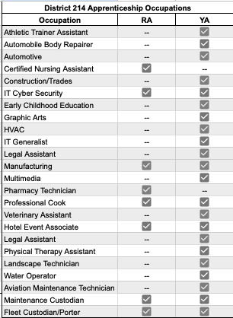
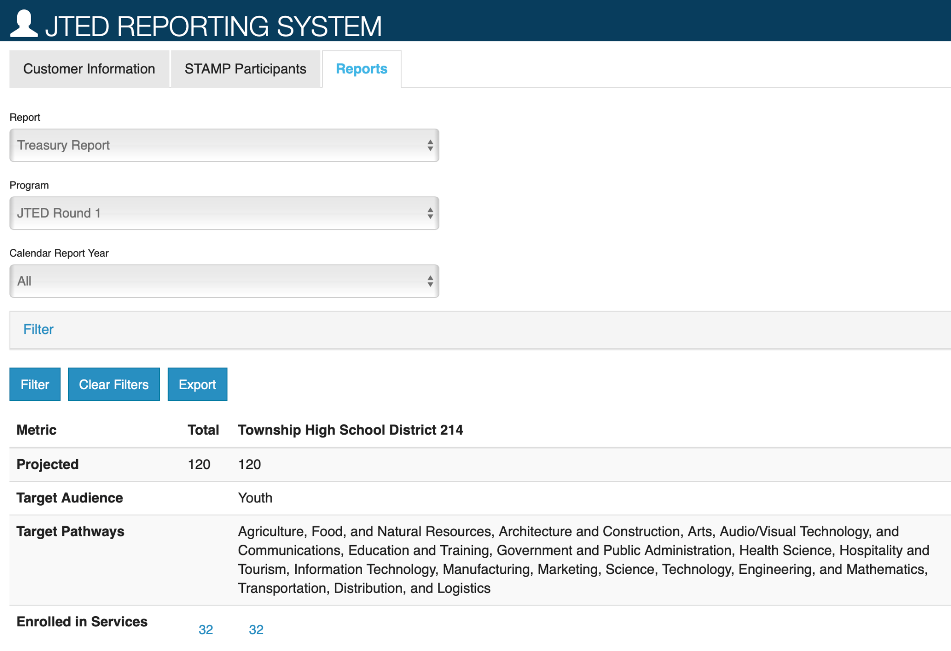
Example
Notes:
Marcella

Slide 28
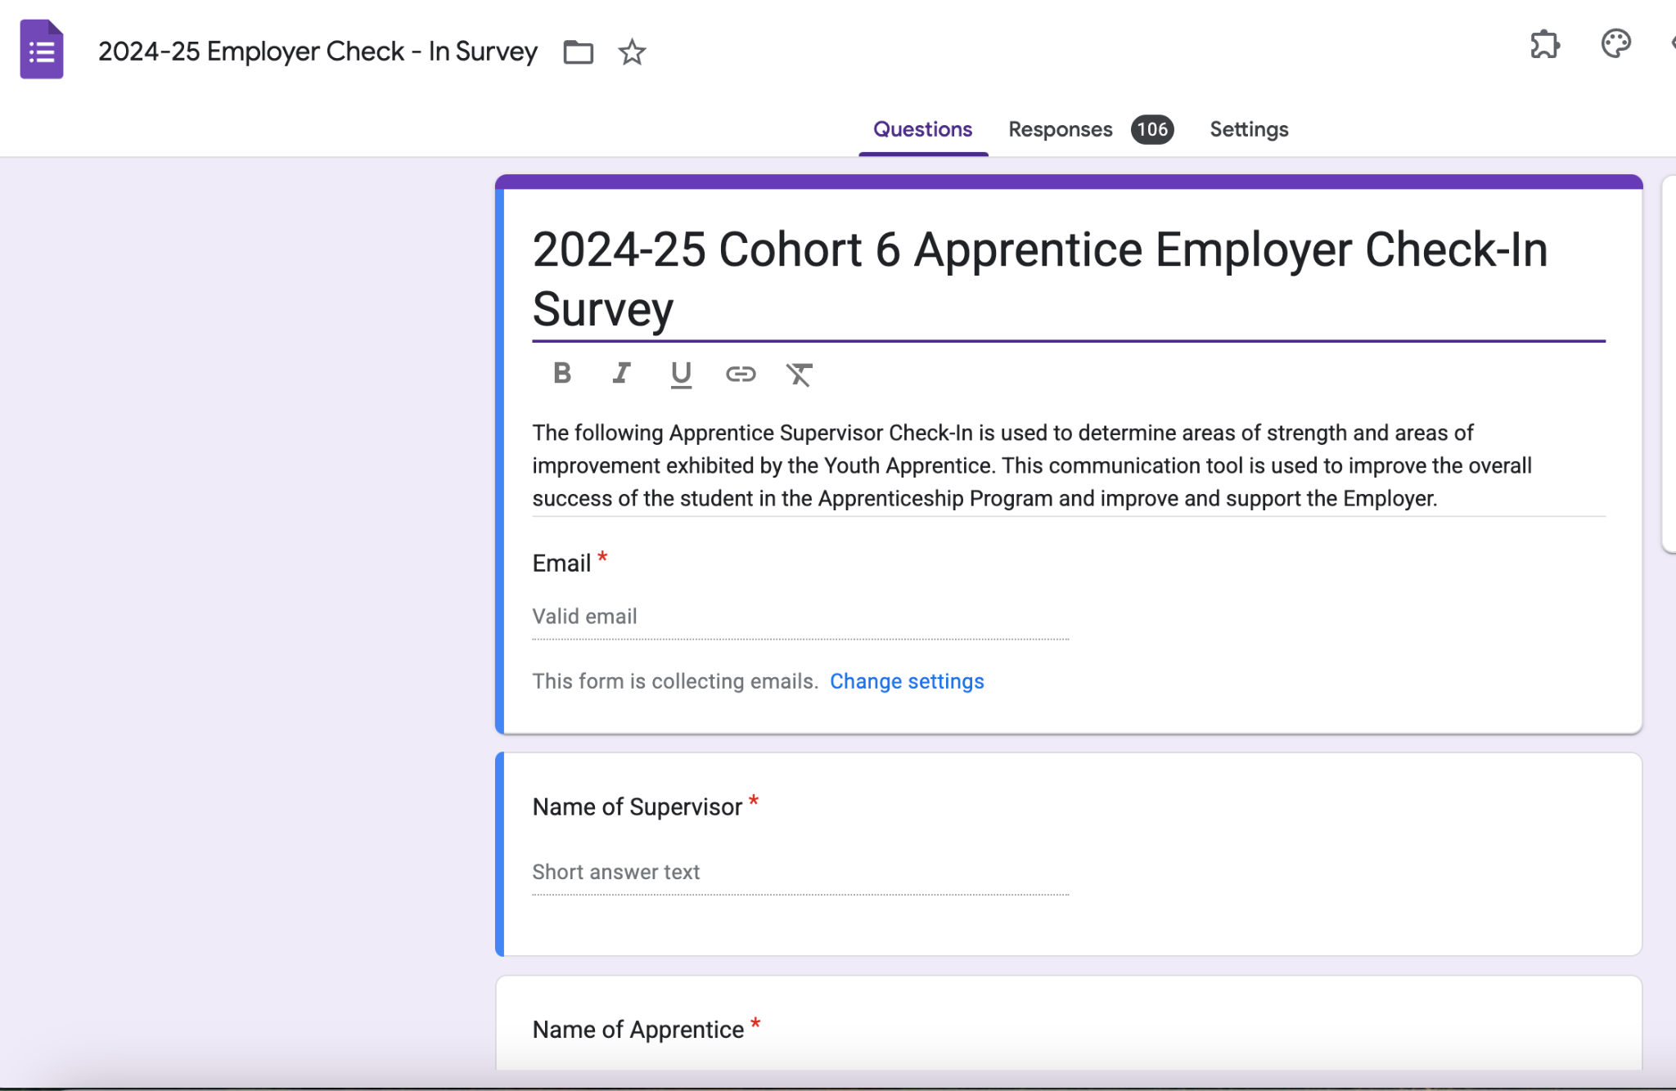
Maintain ongoing engagement with partners for long-term viability
Continuous improvement
Stewardship
Notes:
And, of course we can’t forget the softer side of the District/employer partnership. D214 plans a calendar full of various stewardship activities to express gratitude for our continued partnerships and to strengthen and grow those partnerships. Strong partner relationships are responsible for opening new and different opportunities with employers in different career areas or with different functions or subsidiaries (i.e. NCH CNA leading to Pharma and Biomedical Engineering).

Slide 29
Questions?
Thank you for attending
Laz Lopez
lazaro.lopez@d214.org
Marcella reca-zipp
marcella.zipp@d214.org
Barb kain
barb.kain@d214.org
Kathy gannon
kathy.gannon@d214.org
Notes:
LAZ

Slide 30
APPENDIX
Notes:
Kathy

Slide 31
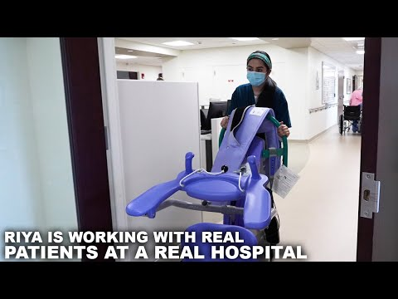
Apprentice in Action
Notes:
Kathy

Slide 32
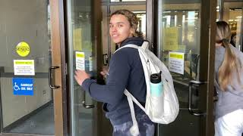
A Day in the Life of a CNA Apprentice

Slide 33
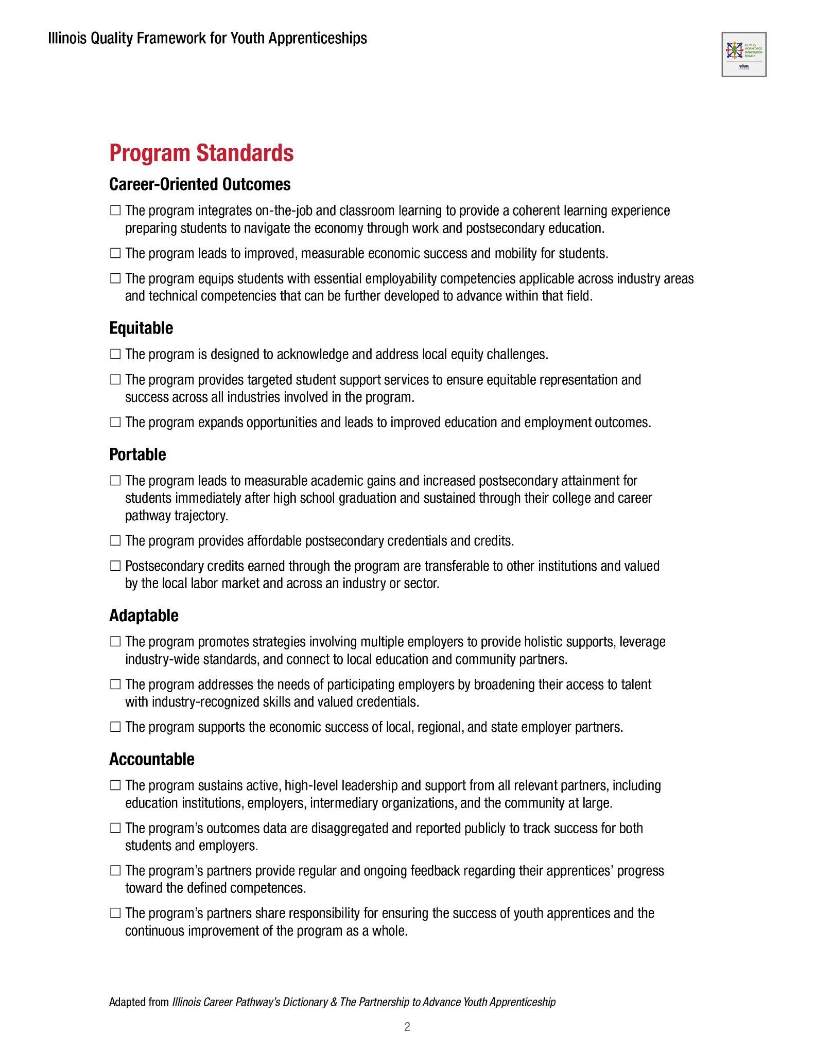
Notes:
Marcella

Slide 34
Compliance & reporting

