Slide 1
Illinois Youth Career Pathway Grant Opportunity Technical Assistance Session
Illinois Department of Commerce and Economic Opportunity

Slide 2
Moderator & Technology Support
Kiersten Baer
Online Marketing Coordinator
Illinois Center for Specialized Professional Support
ksheary@ilstu.edu

Slide 3
Access and Participation Guidelines
Meeting Access
Meeting Participation
Select the “Call Me” option on Zoom to use your phone for audio while using the video option, if you choose.
This webinar will be recorded and posted to IWN.
Everyone will be muted for this webinar.
A FAQs Page has been created to track questions raised during the webinar.
Materials shared during the meeting will be available on workNet.

Slide 4
Career Development Experiences

Slide 5
Speaker
Heather Penczak
Director of Innovation and Implementation
Education Systems Center

Slide 6
Work-Based Learning Continuum
Career Awareness
Career Exploration
Team-Based Challenge
Career Development Experience
Pre-apprenticeship / Youth Apprenticeship
Apprenticeship
Increasing Intensity of Employer Engagement
Definitions: Illinois Career Pathways Dictionary

Slide 7
Career Development Experience (CDE)
A supervised work experience relating to an individual’s career area of interest that:
Occurs in a workplace or under other authentic working conditions;
Is co-developed by an education provider and at least one employer in the relevant field;
Provides compensation or educational credit to the participant;
Reinforces foundational professional skills including, at a minimum, those outlined in the Essential Employability Skills framework;
Includes a Professional Skills Assessment that assesses skill development and is utilized as a participant feedback tool; and
Takes place for a minimum of 60 total hours.
Source: Illinois Career Pathways Dictionary

Slide 8
CDEs are commonly known as..
Internship
School-based Enterprise
Supervised Agricultural Experience
Cooperative Education
Remote Work for a Client or Employer
Student-led Enterprise
Youth Apprenticeship

Slide 9
Career Development Experience Toolkit
Establish expectations for implementing high-quality, rigorous work-based learning experiences that prepare young people to be college and career ready through the development of Essential, Entrepreneurial and Technical Employability Competencies
Provide guidance, tools, and frameworks to offer a Career Development Experience, which is a required component of the College and Career Pathway Endorsement framework and in the State’s Every Student Succeeds Act (ESSA) as a College and Career Readiness Indicator
Highlight best practice examples of how organizations are accomplishing this on-the-ground and spark thinking for other communities on how these examples might be modified to fit into their own unique context

Slide 10
CDE Toolkit Resources Include:
Toolkit Document: A PDF document is available for download and guides readers through each stage of implementation with links to related resources and materials
Toolkit Website: The website includes links to all resources and materials referenced in the document and will be updated monthly with additional resources and best practices
Customizable Templates: Within the document and website are links to templates that can be customized to reflect the unique context and needs of each community and organization
Link to CDE Toolkit Website

Slide 11
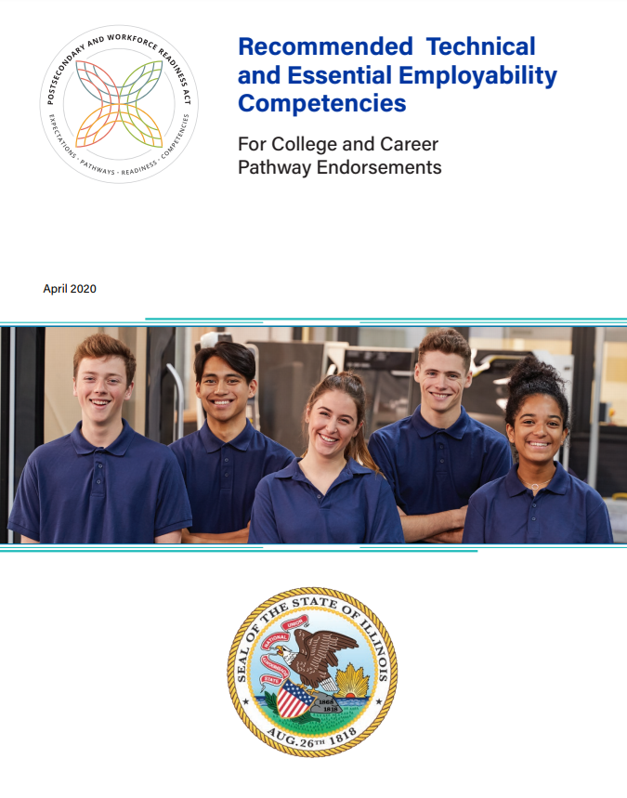
Essential Employability and Technical Competencies
Link to competencies

Slide 12
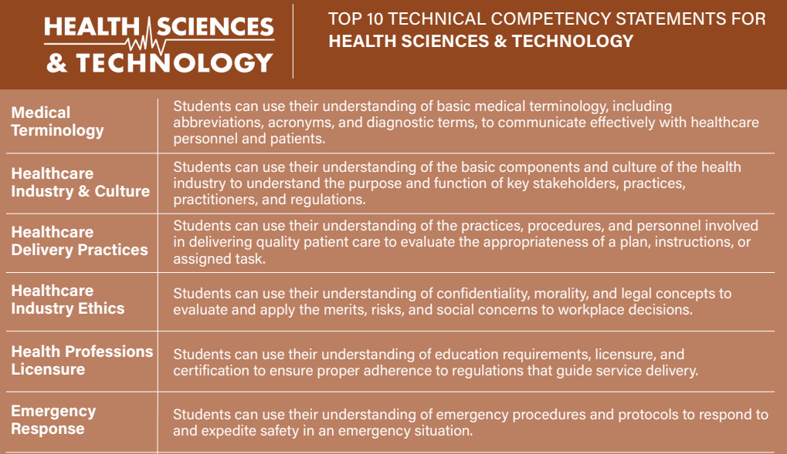

Slide 13
CDE Models
“Typical” internship with tasks and deliverables assigned by the Host on a daily/weekly basis
Micro-internships with project-based tasks
Ready-to-go projects
What are the things Hosts wish they had time to research/complete?
Departmental rotations
Expand Participant’s awareness of opportunities within an industry area
Entrepreneurial endeavors
Current part-time job aligned with competencies

Slide 14
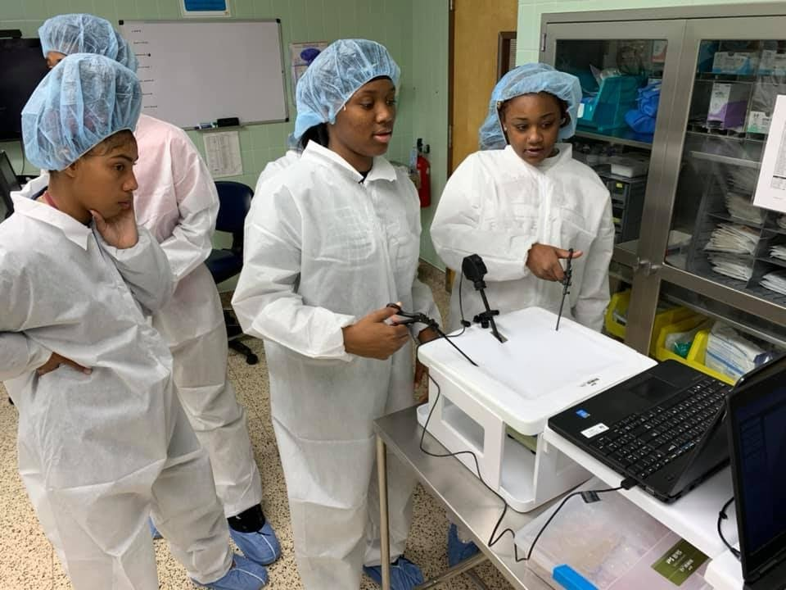
Participant Experience in a CDE
Exposure to a new environment and expectations to support growth of Essential Employability & Technical competencies
Authentic, quality engagement with industry professionals to build social capital and connection to college and career pathways
Valued as a resource of talent with background knowledge and lived experience that are recognized as a benefit to the CDE Host
High School Interns at BJC Healthcare

Slide 15
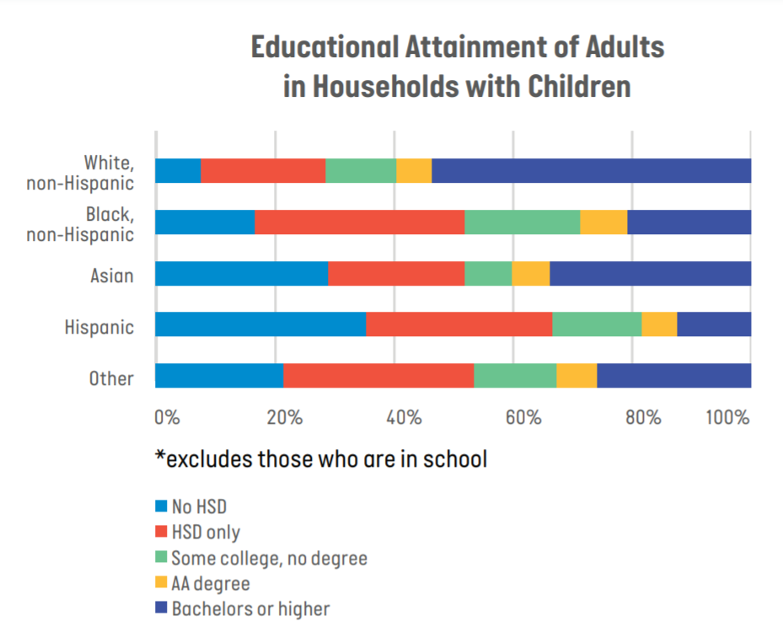
Social Networks & Access to Information
Research from Murillo et al., (2017)
Internships are providers of capital and opportunity to help students acquire the skills and knowledge needed to navigate the work and educational environment typically inaccessible to marginalized student populations
Even when low-income students of color have the academic qualifications to attend college, a large number do not apply to college because they lack information, guidance, and access to resources
Source: HERE to HERE Policy Brief

Slide 16
Relationships – Participants & Hosts
Expectations are explicit and reviewed before the first day of the CDE
Clear points of contact for Participants and Hosts to address questions, provide resources for support and resolve issues
Engage Participants and Hosts in feedback on their experiences
Consistent check-ins between Participants and Hosts
Participants and Hosts are celebrated for their achievement and support

Slide 17
Stages of Implementation
Getting Started | Outreach | Onboarding | During | Wrapping Up
Clearly define roles and responsibilities of team to be able to communicate to Hosts & Participants Provide any relevant PD for staff Determine industry area(s) and general CDE model | Determine how CDE opportunities will be communicated so that all eligible Participants are provided the same information Recruit and assess potential Hosts to determine readiness for a CDE | Meet 1-1 with Participants to address transportation and support needs Are there any specific HR requirements from the Host for Participants to complete? | First days, mid-point check-ins to monitor progress and address needs to proactively navigate challenges Site visits for longer term CDEs and new Hosts Begin discussions on the Professional Skills Assessment | Provide an opportunity for both Participants and Hosts to evaluate one another and reflect on their experience Gather testimonials Support Participants to update resumes, portfolios, etc.

Slide 18
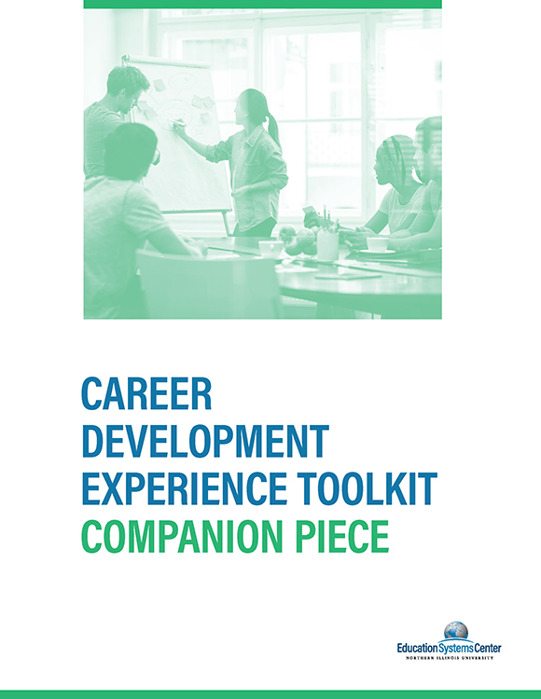
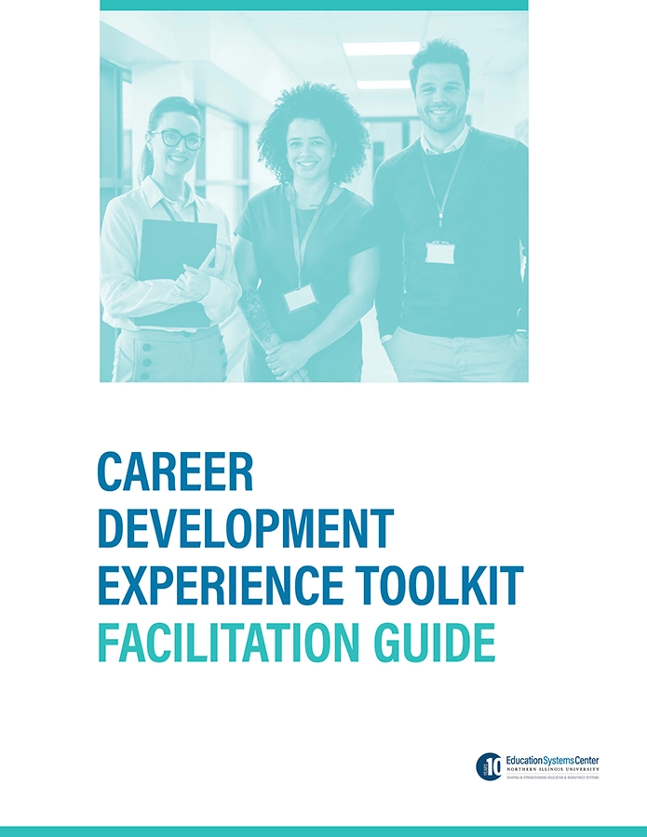
Additional Resources
CDE Toolkit Companion Piece
CDE Toolkit Facilitation Guide

Slide 19
CDE Toolkit Companion Piece
The purpose of this extension is to explore Career Development Experiences and provide resources to address the needs of stakeholders outside of a traditional high school setting including: workforce development organizations, community-based organizations and alternative high schools. This companion piece targets these organizations and employers in order to serve youth more inclusively.

Slide 20
WIOA Youth Program & CDE Elements
Supportive Services
Adult Mentoring
Follow-up Services
Financial Literacy Education
Services that Provide Labor Market Information

Slide 21
Types of Models in Companion Piece
Type of Model | Community Model | Host-led Model | Federal Model
Definition | A partnership between a Host and a Managing Organization. Usually, the Managing Organization identifies and trains Participants and the Host provides work-related tasks and oversight through supervision and mentoring by a designated Host Supervisor. | Hosts have their own internal practices for acquiring new talent and building their skills. In a Host-led model, the Host recruits Participants, provides ongoing training, and works to retain Participants for the host company. | National, funded efforts are underway to support Opportunity Youth’s reconnection to education or employment. We can learn from these models for local implementation of CDEs.
Example | Business and Career Services, Inc. | Caterpillar | Opportunity Youth Forum

Slide 22
Equitable Practices
Payment/stipend
Participants are often asked to pick between a meaningful CDE experience and a job that covers essential costs
Transportation stipend to address barrier to equitable access, especially in smaller cities and rural communities without public transportation
Flexible scheduling
Participants may have many competing priorities, depending on their circumstances. Assigning work that can be completed around their schedule increases capacity for participation.
Some Participants have other childcare responsibilities.
Virtual opportunities
The various barriers Participants face can be lowered through virtual CDE opportunities (transportation, cost, time spent traveling, etc.)
Offering opportunities to connect or work virtually whenever possible keeps equity at the forefront of the CDE.

Slide 23
CDE Toolkit Facilitation Guide
The purpose of this document is to provide a guided checklist for communities to design and implement a Career Development Experience
This document is meant to be used in conjunction with the Career Development Experience Toolkit and Companion Guide in which community models, best practices, and resources for WBL are outlined.
Relevant sections of the CDE Toolkit and Companion Guide will be linked throughout this guidebook for your reference and ease, as well as additional resources to support your design and implementation process.

Slide 24
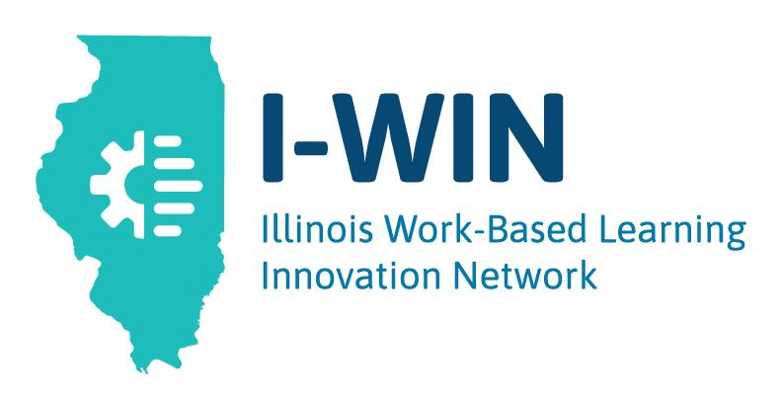
Highlight and explore innovative models for work-based learning, initial focus on virtual
Engage in conversations on creating sustainable, high-quality models that provide broader and more equitable access, focusing on building social capital for Black and Latinx students
Build connections among communities to share best practices, learnings and resources
Identify needs for state policy changes or support systems
Explore the I-WIN Resource Hub and subscribe to the newsletter

Slide 25
Thank you!
Heather Penczak, hpenczak@niu.edu

