Slide 1
Illinois Youth Career Pathway Grant Opportunity Technical Assistance Session
Illinois Department of Commerce and Economic Opportunity

Slide 2
Moderator & Technology Support
Kiersten Baer
Online Marketing Coordinator
Illinois Center for Specialized Professional Support
ksheary@ilstu.edu

Slide 3
Access and Participation Guidelines
Meeting Access
Meeting Participation
Select the “Call Me” option on Zoom to use your phone for audio while using the video option, if you choose.
This webinar will be recorded and posted to IWN.
Everyone will be muted for this webinar.
A FAQs Page has been created to track questions raised during the webinar.
Materials shared during the meeting will be available on workNet.

Slide 4
Workers’ Rights and
Young Workers in Illinois
May ___, 2023
DCEO Professional Development Committee
Alison Dickson
Senior Instructor
Labor Education Program
aquesada@illinois.edu

Slide 5
Agenda
Connecting workers’ rights to job training programs
Workers’ rights 101 preview: Wage theft, minimum wages differences, discrimination…
Documenting strategies
Next steps:

Slide 6
OPPORTUNITY: Institutionalizing workers’ rights education and worker power and voice in education and job training programs

Slide 7
Why teach
workers’ rights?
Epidemic of wage theft $7.3 million/week stolen from low-wage workers in Cook County (2009)
Lack of education Workers do not learn this information anywhere else - not in high school, not on the job - only when they have a problem

Slide 8
Why connect with
workforce development?
Job readiness Part of being “job ready” is knowing your rights as a worker
Financial literacy Protecting against wage theft and other workplace violations helps workers earn more $ and better support their families
Perfect partnership Workers + mission-driven CBOs/educational institutions + career focused education

Slide 9
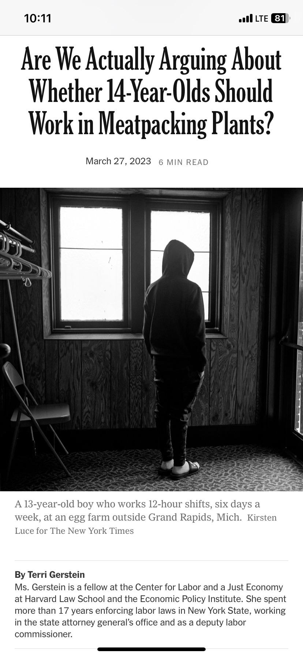
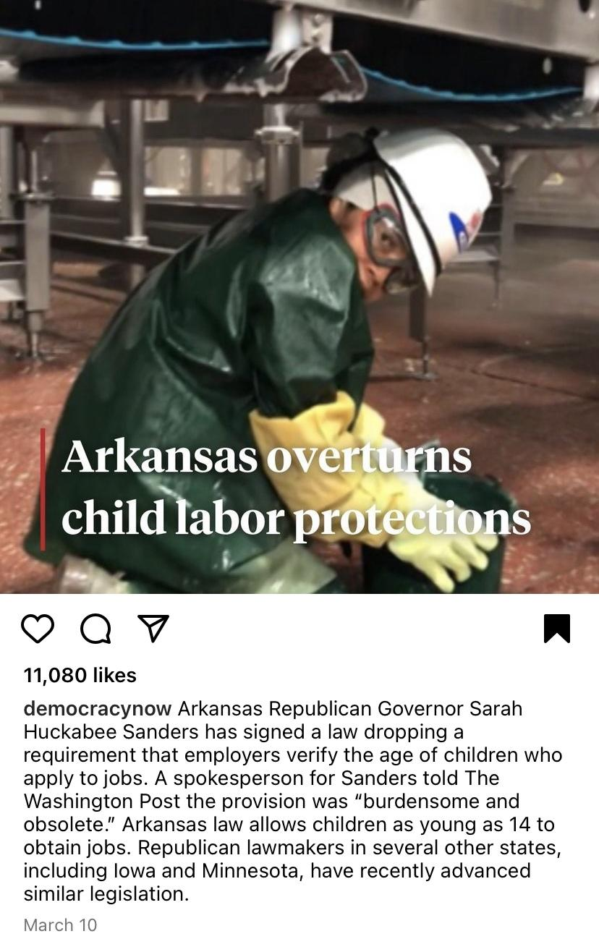
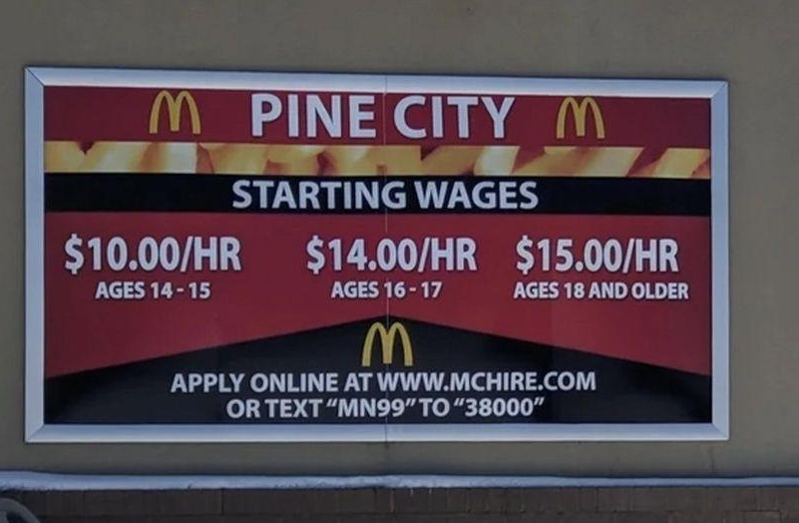

Slide 10
Extension teaching activity: Job training program class discussion about precarious work
SCENARIO: Ryan, of Fast and Easy Painters, hires a few painters for a paint job in Bolingbrook. He says he will pay them $15 an hour and that they must start work on Monday morning at 8:00 am.
On Thursday, one of the painters, Piotr, slips and falls off of the scaffolding and breaks his ankle. Ryan claims Piotr is responsible for his medical bills because he hired him as an independent subcontractor.
What do you think?
Wage theft
Worker injuries and illness
Lack of awareness/education of workers’ rights
Discrimination - xenophopia

Slide 11
Is Piotr an independent contractor or employee? How do you know? Why does this matter?
What should workers’ comp provide him?
What if:
Ryan has vanished and Piotr can’t find him?
Piotr is undocumented?
Ryan hired Piotr from the Home Depot parking lot?
How should Piotr be documenting his working conditions to protect himself?
Who else can help Piotr?
How do Piotr’s workers’ rights change if he takes a job in Indianapolis?

Slide 12
Independent contractor v. employees
An independent contractor is a worker who makes arrangement with a customer or client, brings her own equipment, sets her own work schedule, and carries her own insurance.
For example: a plumber, a computer tech, an accountant, a nanny, a hair stylist, or house cleaner. These workers often work on their own as their own bosses.
Piotr is an employee, not an independent contractor, and is entitled to Workers Compensation (Illinois Department of Labor).

Slide 13
Misclassification
An employer claims their worker is an independent contractor, when legally she should be an employee.
Ex: A cleaning agency classifies its workers as independent contractors, even though the company sets the work schedules and provides the cleaning equipment.
If the workers are called independent contractors, the company does not have to follow many important workers’ rights laws.
They do not pay overtime or benefits such unemployment compensation and workers’ compensation.
They also do not make deductions for taxes or Social Security.
The worker loses money and the protections of labor laws.

Slide 14
Workers’ compensation
An insurance system that all employers must carry to cover employees who are injured on the job.
Workers’ compensation (or workers’ comp) covers all work-related injuries, regardless of fault.
Piotr is an employee and is entitled to workers’ comp. In Illinois, workers comp is a “no-fault” system and pays for 100% of medical bills (Illinois Workers’ Compensation Commission).

Slide 15
Wage theft
Wage theft, or non-payment of wages, is illegal.
If your employer refuses to pay you the wages you are owed, s/he is violating federal and state wage laws.
You have the legal right to be paid for your work regardless of your documentation status.

Slide 16
Piotr’s documenting strategies…
Record of work hours (CALENDAR)
Address of worksite/home owners’ contact info (JOURNAL/PHONE)
Collecting coworkers contact info (JOURNAL/PHONE)
Photos of contractor license plate number (PHONE)
Hospital records; workers’ comp forms (JOURNAL)

Slide 17
Groundbreaking, first in the nation curriculum and accompanying professional development through CJC’s Frontline Focus Training Institute
3rd edition available for download!!
https://lep.illinois.edu/workers-rights-for-all/workers-rights-curriculum/
Notes:
-open-sourced, free to download, updated annually due to changes in the law and administrations

Slide 18
Methods
Intro to workers’ rights on the job
Wage & hours laws and protections
Getting hired, disciplined & getting fired
Leaves of absence
Discrimination on the job
Worker health & safety
Organizing workers
Curriculum Structure:
8 units with pick and choose modules:
Notes:
-10-30 min modules based on a variety of teaching/learning methods and techniques

Slide 19
Connecting WR to existing job training programs...
Skills | Workers’ Rights Curriculum
Interviewing | Recognizing illegal discrimination in hiring
Communication | Talking with a coworker or government agency about a problem on the job
Reading | Comparing/contrasting employee handbooks and collective bargaining agreements
Math | Reading paychecks - calculating OT and shift differentials and identifying illegal deductions
Writing | Journal is kept - recording information about incidents/problems as well as hours and pay

Slide 20
Activity: Practicing math skills and reading a check stub.
What’s wrong here?

Slide 21
Workers’ Rights 101 Let’s explore strategies for protecting yourself on the job… Assume the workers in every case study work in Illinois, are at least 16 years old, and are non-union (at-will)

Slide 22
Jeremy waits tables at an Olive Italiano restaurant in Peoria. His shifts starts at 11:00 am, but his manager insists he arrive by 10:45 am so that his station is ready for the lunch service.
Is Olive Italiano required to pay Jeremy for this extra 15 minutes?

Slide 23
YES
Issue areas
Wage theft (off-the-clock work)

Slide 24
Common forms of wage theft…
Fail to pay overtime
Violate minimum wage laws
Misclassify employees
Take illegal deductions from paychecks
Require workers to work for no pay, or “off the clock”
Steal workers’ tips
Not pay workers for training
Not pay out or allow accrued vacation/sick time
Pay with checks that bounce
Suddenly close a business without paying a final check

Slide 25
At-risk for wage theft…
Young workers
Immigrant workers, especially those who are undocumented
Returning citizens/ex-offenders
POC in general
Women; working mothers
Certain industries maintain a culture of wage theft (car washes, temp work, non-union construction, domestic work).

Slide 26
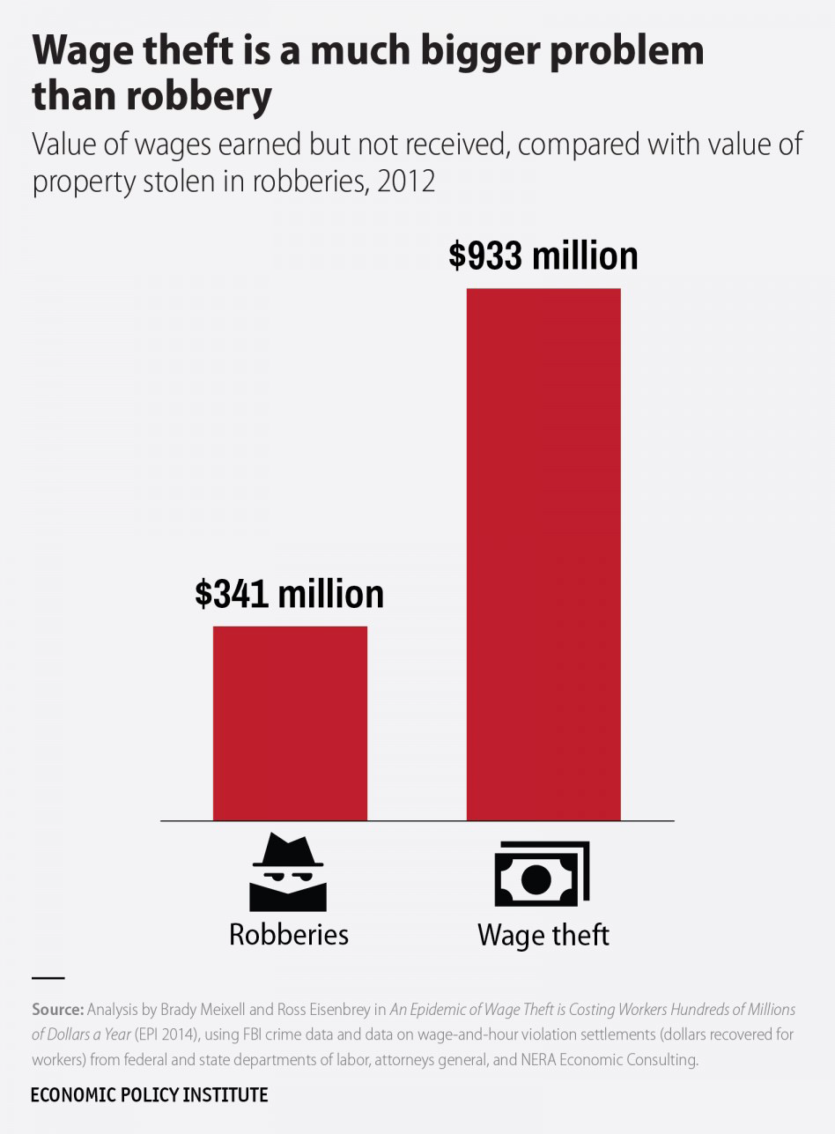

Slide 27
Jeremy’s documenting strategies…
Record of work hours (CALENDAR)
Check stubs (FOLDER)
Journal of tips received (JOURNAL)
Collecting coworkers contact info (JOURNAL/PHONE)

Slide 28
A global pandemic plus polar vortex mean that most of Olive Italiano’s business has switched to take-out orders. Jeremy no longer has tables to wait and is helping package customer orders .
Before the pandemic, Jeremy was paid a tipped sub-minimum wage in addition to his tips. Can his employer continue doing this now?

Slide 29
Depends
Issue areas
Minimum wage differences
Wage theft

Slide 30
Minimum wages
Minimum wage is the lowest amount per hour an employer can pay a worker. The federal minimum wage is $7.25 and sets the floor for US workers.
Minimum wage levels vary by state, county, city, and even by occupation. Local and state governments have passed their own minimum wage laws.
There are also sub-minimum wages for workers under 18, tipped workers, and some workers with disabilities.

Slide 31
2023 minimum wages
CITY OF CHICAGO
$15.40/hour
$23.10/overtime hours
$9.24/tipped wage
$12.00/YOUTH*
COOK COUNTY
$13.35/hour**
$20.03/overtime hours
$7.80/tipped wage
*Beginning, January 1, 2020, if a worker under 18 works more than 650 hours for the employer during any calendar year, they must be paid the regular (over 18 wage).
**Many Cook County municipalities have opted-out of the minimum wage increase. They are still subject to the Illinois minimum wage increases.
ILLINOIS (outside Cook)
$13.00/hour
$7.80/tipped wage
$10.50/YOUTH*
INDIANA
$7.25/hour
$2.13/tipped wage
WISCONSIN
$7.25/hour
$2.13/tipped wage
IOWA
$7.25/hour
$4.35/tipped wage

Slide 32
Jeremy’s documenting strategies…
Record of work hours
Check stubs
Journal of tips received
Collecting coworkers contact info

Slide 33
Melanie works as an office assistant for a medical office in Schaumburg. Traffic on the Kennedy is especially horrible one day and she calls her employer to let them know she will be 15 minutes late to work. When she arrives at her office she is fired. Can Melanie collect unemployment?

Slide 34
Probably yes
Issue areas
At-will employment
Unemployment

Slide 35
At-will employment
An employee can be let go at any time for a good reason, a bad reason, or no reason at all. Likewise, an employee can leave their job at any time without giving notice.
Exceptions to at-will employment:
Fired because of illegal discrimination
Working under a collective bargaining agreement
Fired because of retaliation/whistle-blowing
Working under some other legal contract (different from an employee manual)

Slide 36
Unemployment
In Illinois, unemployment insurance can be denied for “willful misconduct.” (Illinois Department of Employment Security)
Melanie likely was not committing “willful misconduct” if she called her employer to let them know she was going to arrive late.
However, if she is repeatedly late to work, she may be denied unemployment insurance.

Slide 37
Melanie’s documenting strategies..
Tracking work hours and incidents
Phone records
Photos of traffic/screen shot of google maps
Personnel file documents – recognition, reviews

Slide 38
Brianna is 7-months pregnant and works as a cashier at Dollar Commander in Kankakee. Her OB/GYN says she cannot be on her feet for an 8-hour shift. Can she be fired for not being able to stand and operate her cash register?

Slide 39
NO
Potential issue areas
Discrimination

Slide 40
Accommodations
An accommodation is a change in a working situation to improve a worker’s ability to do job.
Examples: making aisles on work floor wide enough for a worker in a wheelchair, changing work schedule for a worker over 40 years old (age related), or enabling a pregnant worker to have more seated work time to avoid back stress.
Under the Illinois Pregnancy Accommodation Law (Public Law 098-1050), employers must allow pregnant women who want to work during pregnancy reasonable job accommodations, such as to take more frequent bathroom breaks or to get help with heavy work or limit lifting.

Slide 41
Illegal discrimination
Brianna must be accommodated and given a chair/have her register lowered. Alternatively, she could rotate her work with another position where she does not need to be on her feet for 8 hours (Equal Employment Opportunity Commission; Illinois Department of Human Rights).
https://www.youtube.com/watch?v=zBIjVXHl1aA

Slide 42
Briana’s documenting strategies…
Record of work hours
Personnel file/past incidents
Journaling incidents with discriminatory behavior/comments (DATE, TIMES, EVENT with factual info, WITNESSES)
Collecting coworkers contact info to prove different treatment

Slide 43
Julia has a felony conviction from a few years ago for stealing some clothes from a store.
She has been out of work for awhile and feels that she never receives call backs from her job applications because of her criminal record. Is this legal?

Slide 44
NO
Potential issue areas
Ban the Box

Slide 45
Kayla is getting ready to go home after finishing her 8-hour shift as a production worker at a Jungle Company warehouse near Joliet. Her supervisor Bruce tells her she needs to stay late since her co-worker Ronald hasn’t shown up. Kayla needs to leave so she can pick up her child from daycare. Can Bruce fire Kayla for refusing to stay past her scheduled shift?

Slide 46
Yes
Issue areas
At-will employment
Overtime
Fair workweek
Unemployment

Slide 47
At-will employment
An employee can be let go at any time for a good reason, a bad reason, or no reason at all. Likewise, an employee can leave their job at any time without giving notice.
Exceptions to at-will employment:
Fired because of illegal discrimination
Working under a collective bargaining agreement
Fired because of retaliation/whistle-blowing
Working under some other legal contract (different from an employee manual)

Slide 48
Overtime
Overtime signifies hours worked beyond the weekly limit, 40 hours, which are paid at one and a half times the regular hourly rate.
If the hourly wage is $10/hour, the overtime wage would be $10 + $5 or $15/ hour.
Most hourly employees are considered non-exempt employees under the Fair Labor Standards guidelines and must be paid at one and a half time the regular hourly rate for all hours worked over 40 in a given week.

Slide 49
Overtime, continued…
There is no maximum number of hours for Kayla’s industry/occupation.
The law only limits the number of hours for youth workers and certain occupations that have to do with public safety (bus driver, pilot, police officer, etc.)
If working the extra hours means she will work more than 40 hours this week, Kayla must be paid overtime, according to federal law (U.S. Department of Labor).

Slide 50
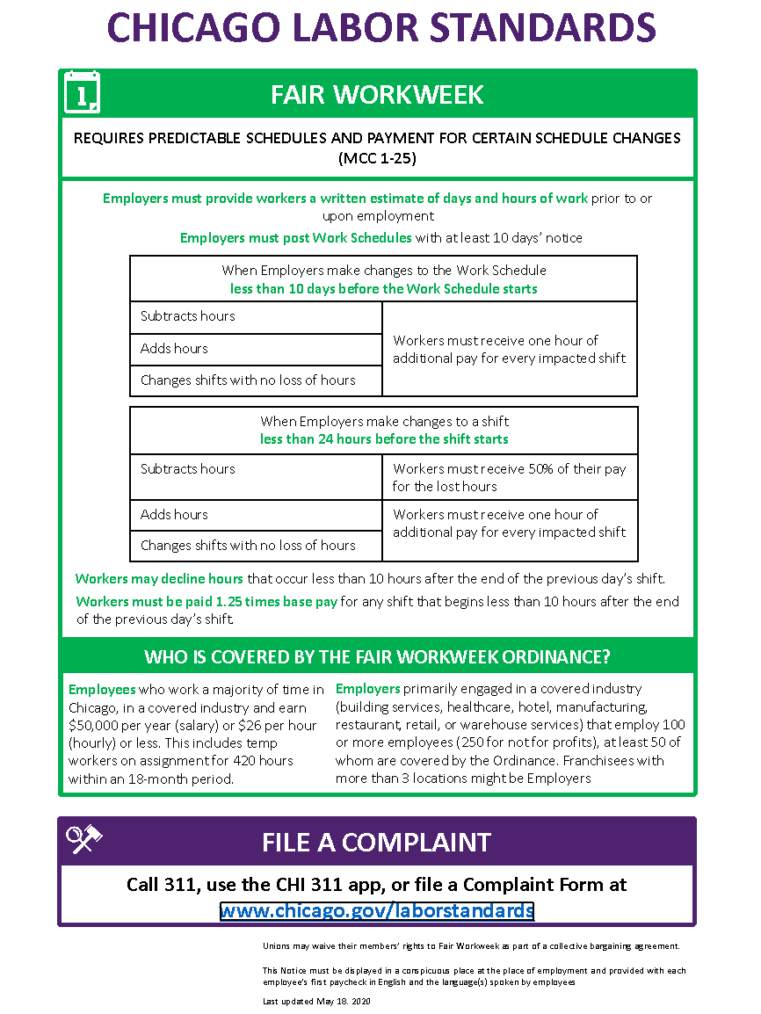

Slide 51
Monique has worked as a line cook at Red Crawfish in Champaign for almost a year. After her one-year anniversary will she be entitled to a week of paid vacation from her job?

Slide 52
Depends
Issue areas
Promised benefits

Slide 53
Vacations
There is no legal right to vacation in Illinois, even if a worker has been at their job for a year.
However, if it is the company policy of Red Crawfish to give one week of paid vacation to their employees after one year of service, Monique must be given her vacation. The company policy can be changed at any time, but if Monique has accrued vacation time before the policy change she must be given or paid this time.

Slide 54
Monique’s documenting strategies…
Collecting employee manual/handbook/memos that outline benefits
Tracking work hours and pay

Slide 55
Samuel works as a CNA at a major metro hospital on the west side of Chicago. He works full time and has been at the hospital for five years. Samuel’s mom has cancer and she needs help getting to her chemotherapy appointments every Friday. Can Samuel take this time off from his job every week to take his mom to the doctor?

Slide 56
YES
Issue areas
FMLA
Paid sick leave

Slide 57
Family Medical Leave Act (FMLA)
FMLA is a federal law that allows you to take up to 12 workweeks off from your job for:
Your own serious illness or health condition (and you are not able to perform your job)
To care for a seriously ill child, spouse or parent
Childbirth or to care for a newborn child up to age one
Adopting a child or receiving a foster child in your home
According to federal law, Samuel should qualify for FMLA leave because: he’s been at his job for more than a year and works more than 25 hours a week; he works for a large employer; he will use the leave to take care of an immediate family member who is ill.
He should be able to take intermittent leave and spread out his FMLA time over a longer period by just taking Fridays off (U.S. Department of Labor).

Slide 58
FMLA (continued)….
FMLA leave is unpaid. But, if your employer or union contract normally pays for sick leave, personal leave or a vacation, you may be allowed to use your paid leave for part of those 12 weeks.
You must have worked 1,250 hours in the 12 months before you can ask for a leave (that’s a little more than half time for most jobs.)
Your employer must employ 50 or more workers.
You can take the leave all at once, or when you need to. Or you can come to work and work fewer hours than usual. You must work out a plan with your employer.
You must ask for leave at least 30 days before you need it. If it’s an emergency, you must tell your employer as soon as possible.
If your employer pays for your health care insurance, your employer must keep paying it during your leave. You should not lose any benefits that you had before your leave.
When you return to work, you must be allowed to return to the same job or another job with the same pay and benefits. No loss of seniority.
Your employer cannot discipline you or discriminate against you for taking time off under the FMLA

Slide 59
Samuel’s documenting strategies…
FMLA paperwork and approval
Tracking work hours and pay
Journaling incidents post-return in case of retaliation

Slide 60
Thank you!
Alison Dickson
Labor Education Program
School of Labor and Employment Relations
aquesada@Illinois.edu

