Slide 1
Department of Commerce & Economic Opportunity (DCEO)
2024 Illinois Works Annual Conference
Illinois Works 2024 Updates
www.illinois.gov/dceo
Notes:
Play music 5-10 minutes before the start of the program: https://www.youtube.com/watch?v=L9-EVKRX064

Slide 2
IWRS Demonstration & Discussion
Natasha Telger
Associate Director
School of Education
www.illinois.gov/dceo

Slide 3
Course Overview
Overview of IWRS Updates
Participant Page
Intake Process
Services Tab
Program Completion
Grantee Details/Cohort Screens
Reports

Slide 4
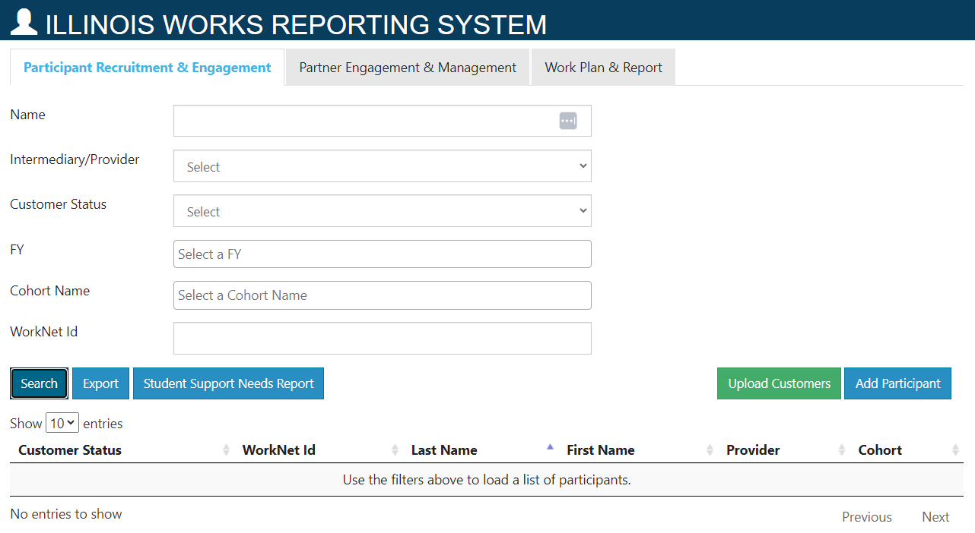
Participant Page – Import Prescreening

Slide 5
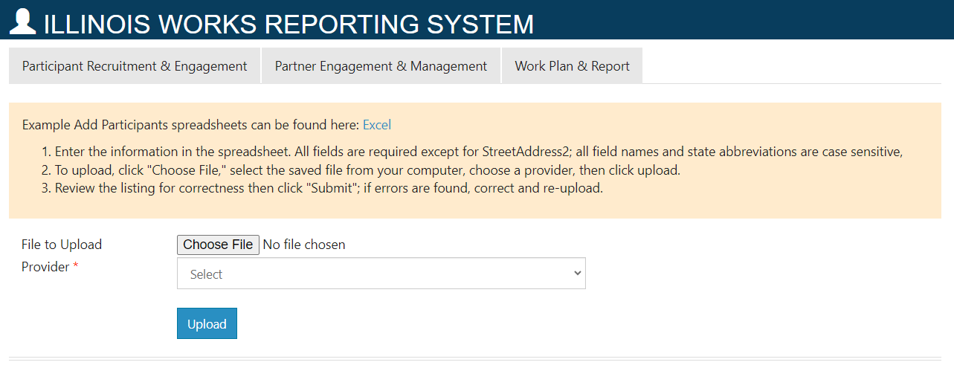
Participant Page – Import Prescreening (continued)

Slide 6
Participant Page – Import Prescreening (continued)
Template allows you to enter up to 100 participants’:
First and Last Name
Phone Number
Email
Inquiry Type (Closed, Cold, Warm, Hot)
Interest in construction industry career? (Yes/No)
Availability to attend program? (Yes/No)
High School Diploma or GED/HISET? (Yes/No)
At least 18 years of age? (Yes/No)
Illinois Resident? (Yes/No)
How did you hear about this program?
Prescreening Result and Date
Sex
Races
Note: You must enter all of this information for all participants in the template. This is not a partial upload.
Note: In the template you may only select one answer for “How did you hear about this program?” and “Races”. Once uploaded, when you select the Inquiry created, you will be able to check the additional boxes, if needed.

Slide 7
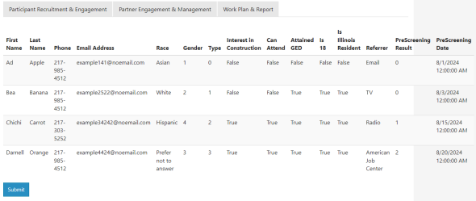
Participant Page – Import Prescreening (continued)
Once you upload the file, on the next screen you will see a summary of the data. If no conflicts, select the button to Submit.
If there are any conflicts they will be noted in red text. Once those conflicts have been addressed and the file has been saved with the updated information, then you can reupload by scrolling to the bottom of the page and repeating the upload process.

Slide 8
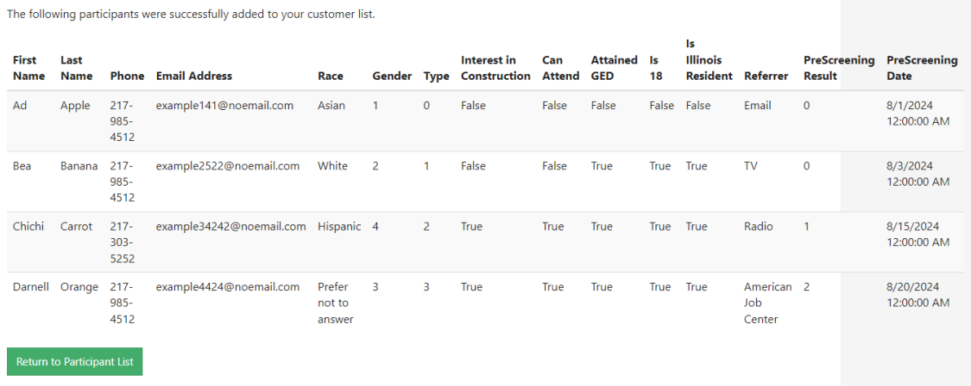
Participant Page – Import Prescreening (continued)
Successful Upload:

Slide 9
Participant Page – Import Prescreening (continued)
Unsuccessful Upload:

Slide 10
Add Participant – Other Update
If you have access to multiple providers in IWRS, an update has been made so that the first selection you make when adding a participant is retained rather than listing the first listed.
This update was made to help address transfer requests in the system.

Slide 11
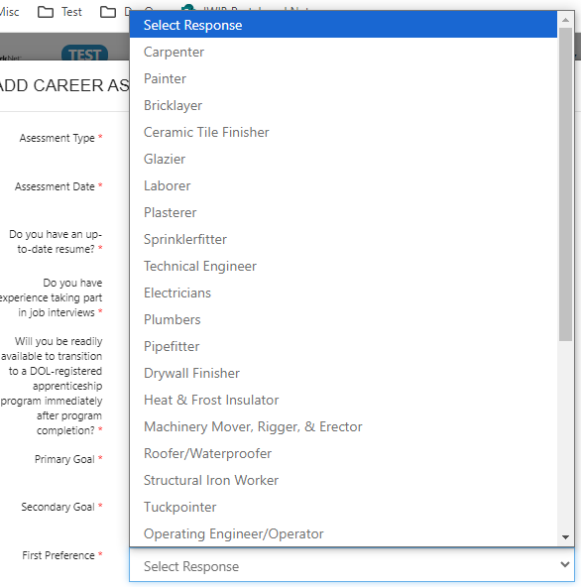
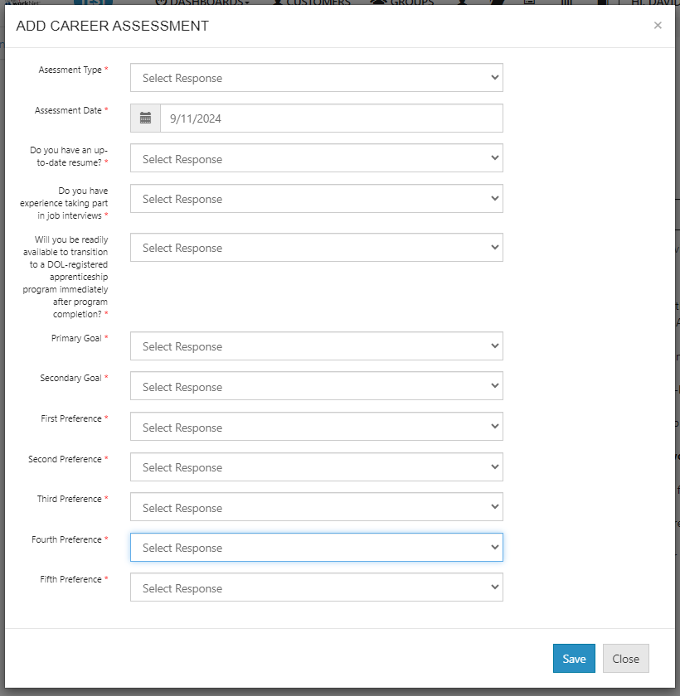
Intake - Career Assessment updated with ranking / prioritization of trades participant is interested in

Slide 12
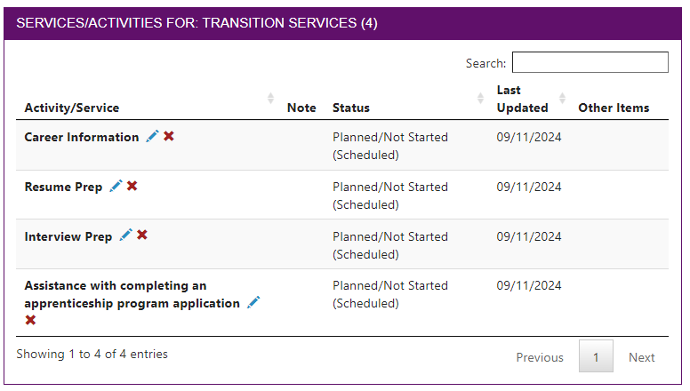
Intake – Completion of Orientation Career Assessment will automatically add services to the Transition Services Goal
Services Added:
Career Information
Resume Prep
Interview Prep
Assistance with completing an apprenticeship program application

Slide 13
Intake – Other Updates
Overview page – Refresh Data/sync has been updated so that the data refreshes when visiting the participant’s overview tab.
Removed ability for grantees to remove enrollment statuses and uploaded documents for proof of high school and interview documents.
Updated Work History Application for customers who are 21+. If 21 or older the selection “I have not worked before. This will be my first job.” will no longer appear. It will appear for those under 21.
Added upload for Wrap Around Support Services.
Bugs resolved:
Credential Flag remained yellow despite having credentials added to service.
Wrap Around Services Assessment services were being duplicated when the assessment was completed - If participants still have duplicates please submit a help request ticket.

Slide 14
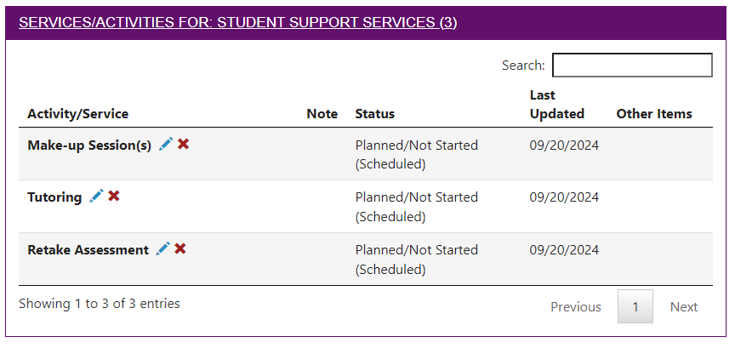
Services – Attendance and Post-Assessment Logic
When a training service has a post-assessment score that is below 70%, then the services “Tutoring” and “Retake Assessment” will populate under the Student Support Services goal.
When a training service has attendance that is below 80% or if make-up session box is checked, then the service “Make-Up Sessions” will populate under the Student Support Services goal.
This will occur when manually editing services in the career plan and when using the Training Services Report.

Slide 15
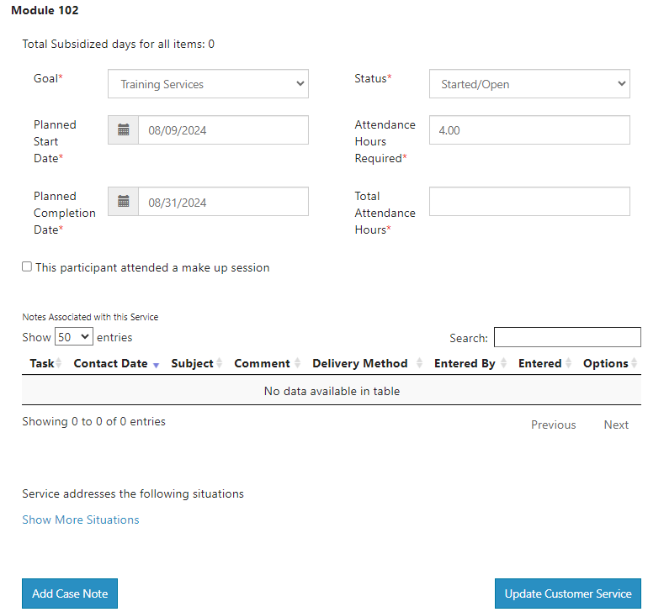
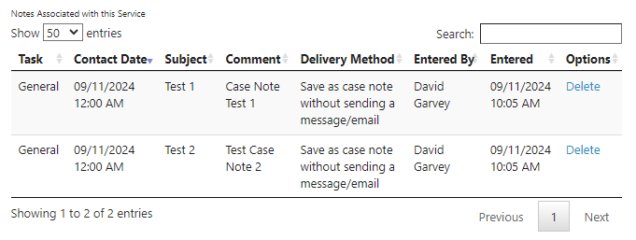
Services – Optional Case Notes and Case Note History added to service

Slide 16
Services – Other Updates
Removed case note requirement for certain statuses (now only required for Unsuccessful Completion and Evaluated/Not Required)
Attendance Hours – now allows decimal points
Standardized tabs for all non-training services – Student Support, Transition, and Wrap Around Services now only have tabs for status, service provider, and dollar value
Bug resolved:
Stipend service – when adding a cost, the entered info was not pulling through to summary table

Slide 17
Program Completion
Lockdown to participant career plan when Final Verification selected by IWRS super admins
Bug resolved:
Case note not saving on program completion tab issue resolved

Slide 18
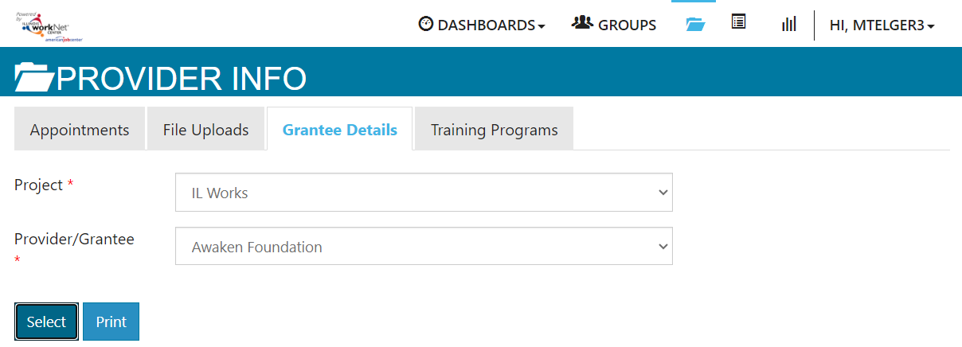
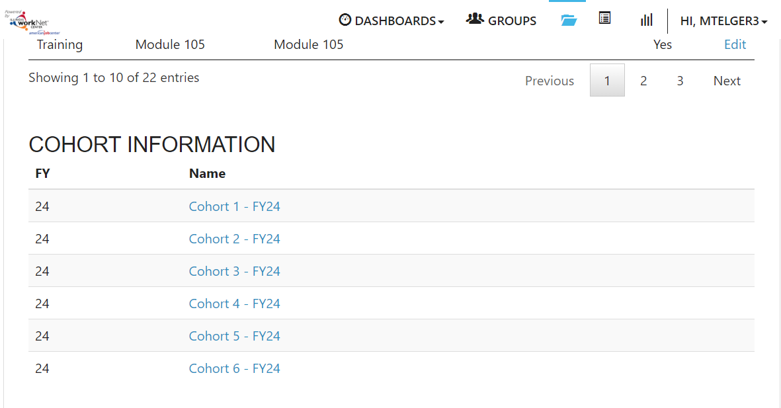
Grantee Details/Cohorts Screen
When logged into IWRS:
Select Provider Info icon
Grantee Details tab
Filter to Project and Grantee
Scroll to bottom to reach Cohort Information section

Slide 19
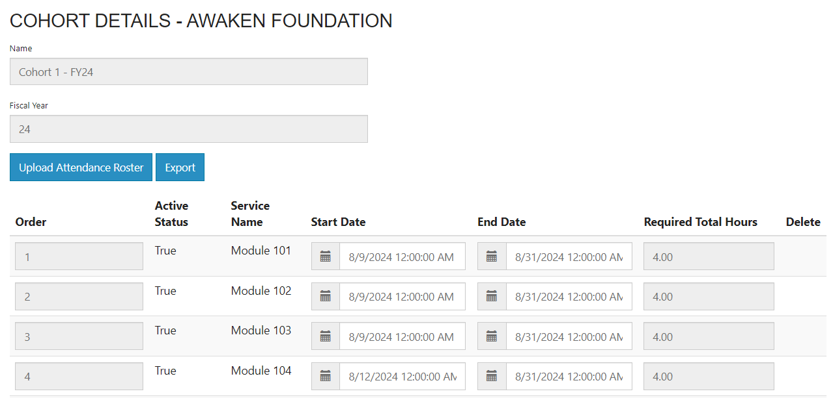
Grantee Details/Cohorts Screen (continued)
Grantees have ability to upload Attendance Rosters for Modules and set the Start and End Dates for Training Services when participants are enrolled to the cohort.
Super Admins have ability to change required hours, order, names of services, add/remove training services.

Slide 20
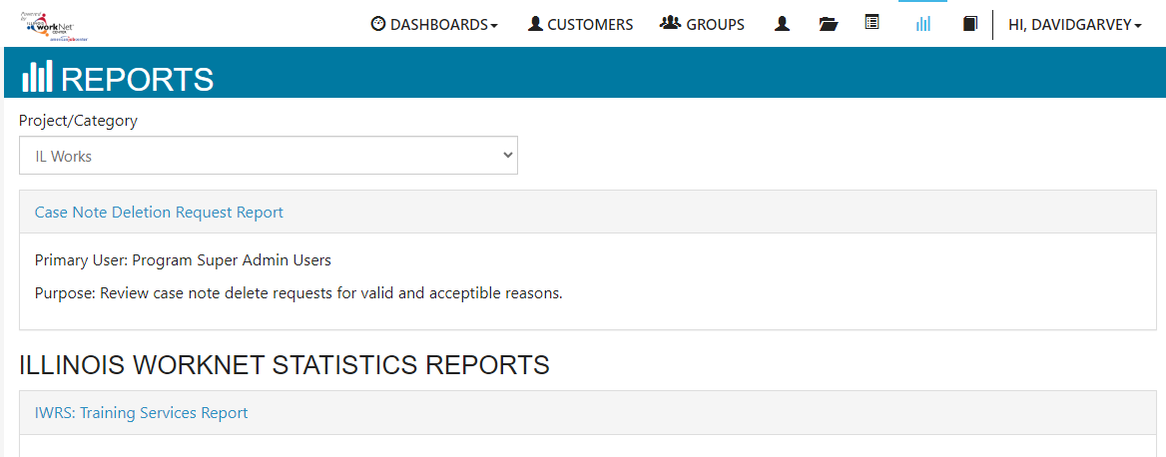
Training Services Report

Slide 21
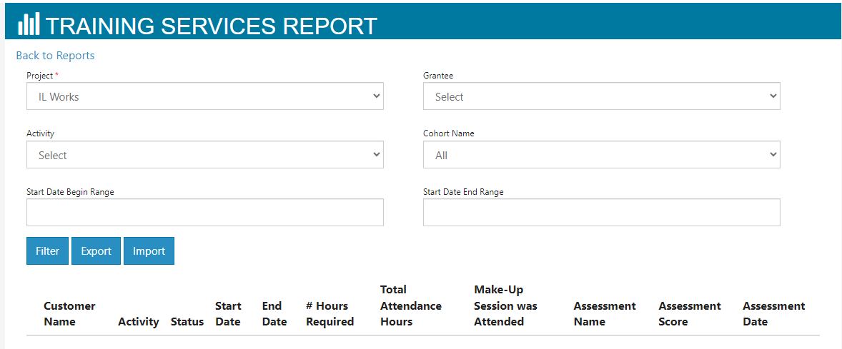
Training Services Report (continued)
Grantees may view the training services by:
Grantee (if access to more than one provider)
Activity (i.e. Training Service)
Cohort Name
Date Range for the start of Training Service
Also, have the ability to Import (coming soon) and Export filtered results in table below.

Slide 22
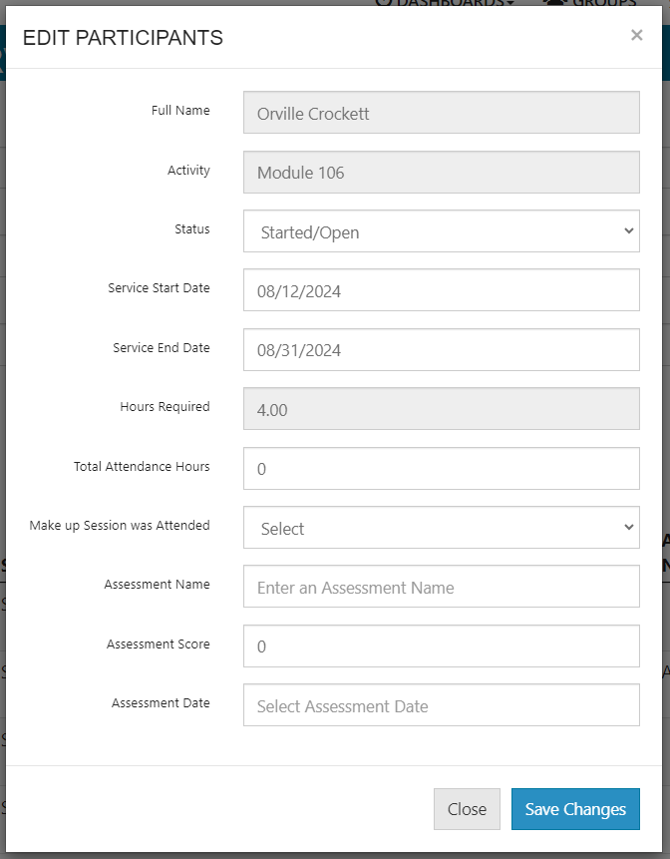
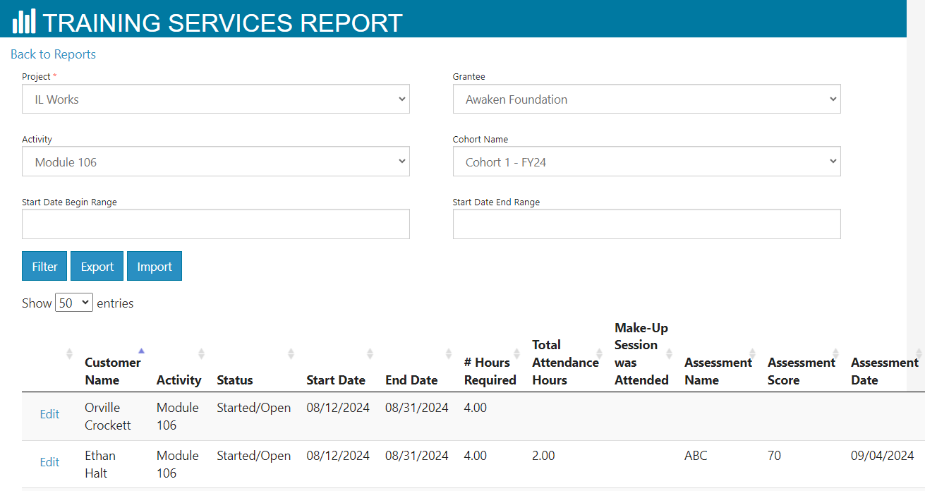
Training Services Report (continued)
To edit, select the Edit next to the Participant’s name.
A window will then open and you will be able to update the Training Service’s:
Status
Start and End Date
Total Attendance Hours
If a Make up Session was Attended
Assessment Name
Assessment Score
Assessment Date

Slide 23
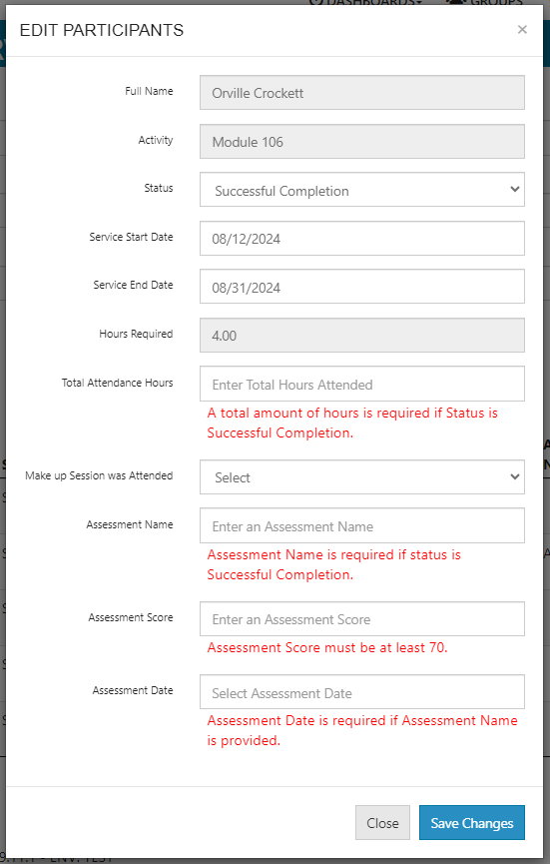
Training Services Report (continued)
If the service’s status is being updated to Planned/Not Started (Scheduled) or Started/Open, you will be able to enter Attendance Hours and/or the Assessment information.
If the service’s status is being updated to Successful Completion, then the Attendance Hours and the Assessment information must meet the passing criteria in order to save (80% of Hours Required, 70% Assessment Score.

Slide 24
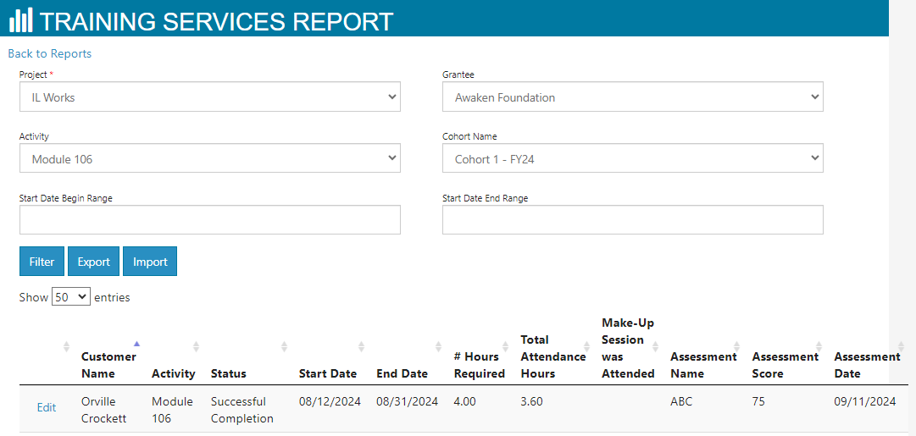
Training Services Report (continued)
Once the information has been entered clicked the Save Changes button.
The table will refresh and you will see that the participant’s service has been updated.
Note: if you make changes to the service in this report or directly on the service, those changes will be reflected in both parts of the system.

Slide 25
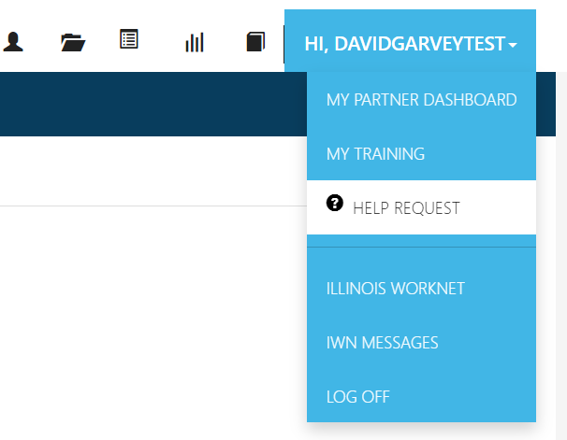
Reports – Other Updates and Help Desk Tickets
Loading icon added to the Student Report and Post-Assessment Report
Help Desk Tickets
If you need any assistance with account conflicts when adding a participant into the system or find an issue, please submit a help desk ticket and include screenshots and/or links to participants.

Slide 26
CEO.ILWorks@Illinois.Gov

Slide 27
Thank You!
David Garvey – david.garvey@siu.edu
Training and Development Specialist
School of Education

