Slide 1
Grantee Reporting System (GRS)
Illinois Department of Commerce and Economic Opportunity

Slide 2
Agenda
Grantee Reporting System – General Information
Requesting System Access
Cost Reporting Procedures
Cash Request Procedures

Slide 3
General Information
Welcome to the Illinois Department of Commerce and Economic Opportunity Grantee Reporting System (GRS).
This is an electronic reporting system consisting of several screens accessible by grantees for the electronic entry of costs, obligations, miscellaneous receipts, disbursements, and cash requests.

Slide 4
Requesting System Access
Illinois Department of Commerce and Economic Opportunity

Slide 5
Grantee Reporting System (GRS) Access
Authorized grantee contacts that access GRS must complete a External Access Request Form
REQUIRED ITEMS: Application Date, Access Requested For, Phone Number, Work Address, City, State, Zip, Email, Applicant Signature, Date

Slide 7
DCEO Grant Information
DCEO Address Information
Department of Commerce and Economic Opportunity
1011 S 2nd Street
Springfield, IL 62704
Grant Manager Contact Information
See Grant Agreement

Slide 8
Grantee Reporting System (GRS) Access
NOTE: The person assigned to the ID should be the person who will be accessing the system to report expenditures and request cash
Once this form is complete and signed, please email to your grant manager

Slide 9
Grantee Reporting System (GRS) Access
Password Reset
“Please reset the password for RACF ID___. I am an OET Grantee who needs access to the GRS.”
CEO.RACFSecurity@Illinois.gov

Slide 10
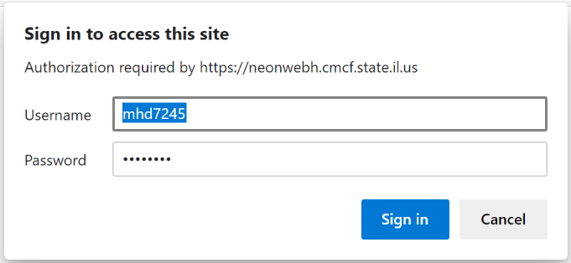
Accessing GRS
https://neonwebh.cmcf.state.il.us/dceo/costrpt
You MUST use Google Chrome, Edge, or Firefox
Enter your username (RACF ID) and password and select Sign in

Slide 11
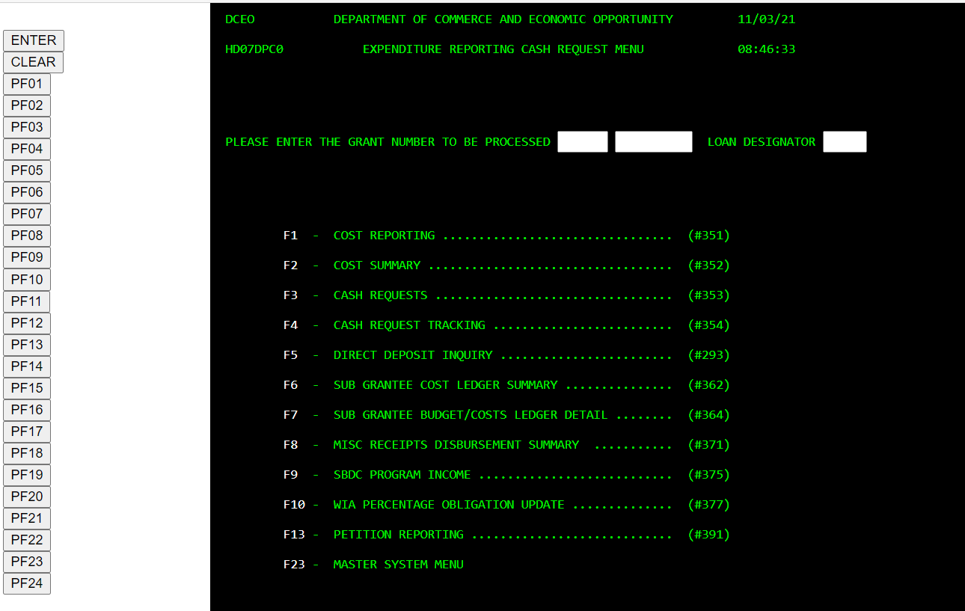
Accessing GRS

Slide 12
Accessing GRS
From this point on, you will be using only the navigation buttons on the left side of your screen. The <PF> buttons on your keyboard will not function properly in the website.
You will not utilize the following menu items from your grant
F9 – SBDC Program Income #375
F11 – Petition Reporting #391
F23 – Master System Menu

Slide 13
Expenditure Reporting
Illinois Department of Commerce and Economic Opportunity

Slide 14
Expenditure Reporting Requirements
DCEO requires grantees to report grant expenditures monthly
Grantees must use the GRS to report costs
Note that grantees may report costs more than once a month
Grant costs that are reported in GRS must “tie back” to the grantee’s accounting system.
Grantees must maintain supporting documentation for all costs reported. This will be monitored.

Slide 15
Expenditure Reporting Deadlines
Expenditures for each month must be entered into GRS by the 20th of the following month.
For example, all active grants right now have the deadline of November 20th to complete their expenditure reporting for the month of October.
If the 20th of the month is on a Saturday or Sunday, the expenditures must be reported by the last business day prior to the 20th.

Slide 16
Reporting Costs #351 (PF01)
Enter your grant number at the top of the screen. The first box is for the first two digits of the grant number and the second box is for the other six digits of the grant number
Click the <PF01> button to go to Expenditure Reporting Screen

Slide 17
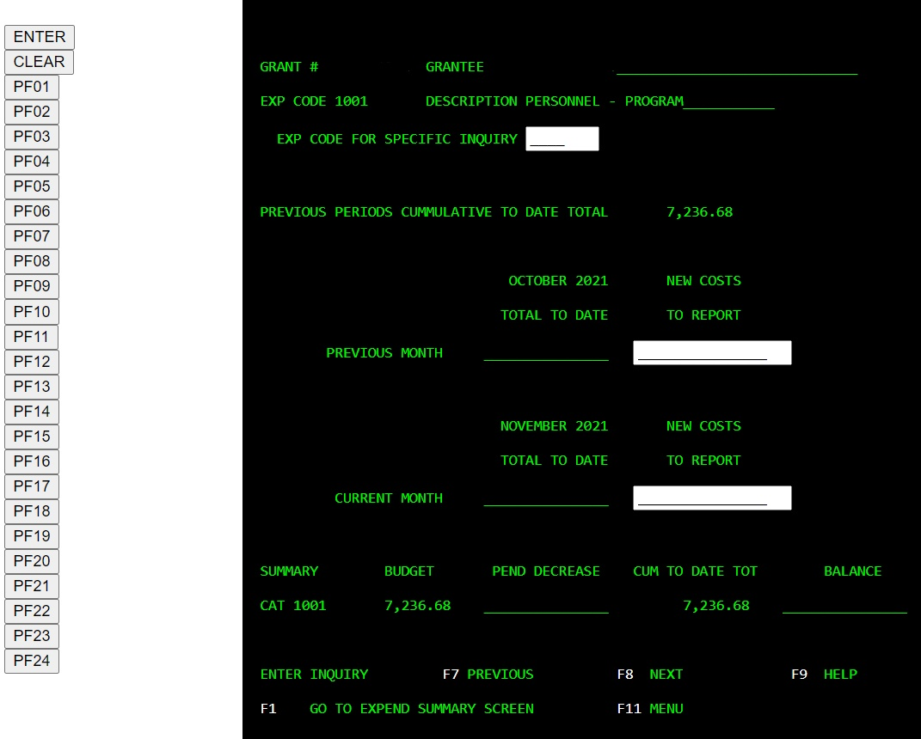
Reporting Costs #351
Ensure the correct expenditure code and description are selected on the screen
If it is not the correct code, you can either scroll using <PF08> until you see the correct code/description or enter the specific expenditure code in the box and press the <enter> button
Determine the month that you are reporting expenditures

Slide 18
Reporting Costs #351
3) Enter the expenditure on the appropriate line
To enter expenditures on another expenditure code, scroll to the desired expenditure code/description
If summary entry is complete, click the <PF01> button to transfer to the Expenditure Summary Screen
Notes:
You must enter the decimal place and cents when entering expenditures. If you do not, the system will place the decimal point in the entry
To reduce expenditures or adjust an incorrect entry, enter the amount followed by a minus sign

Slide 19
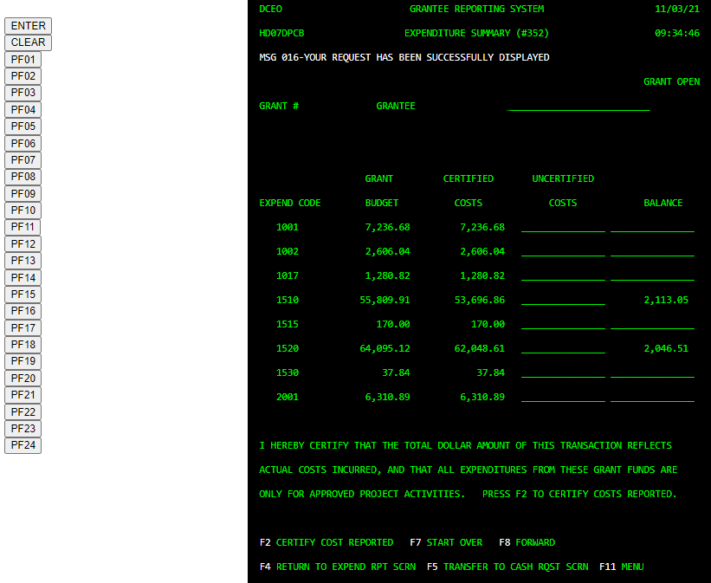
Expenditure Summary #352
Verify the expenditures in the “uncertified costs” column are correctly entered
If they are correct, click the <PF02> button to certify the expenditures. This moves the expenditures into the “Certified Costs” column
If costs are not entered correctly, click the <PF04> button to return to the expenditure reporting screen and correct the entries
Once entries have been confirmed and certified, you may enter a cash request to reimburse for the expenditures entered by clicking <PF05> button

Slide 20
Cash Requests
Illinois Department of Commerce and Economic Opportunity

Slide 21
Cash Request Overview
Grantee use GRS to electronically request cash.
The cash requests require approval from the DCEO accounting and programmatic offices
Cash requests are typically approved on a reimbursement basis.
DCEO will review the cost reported in GRS as part of the cash request approval process. If the grantee has not reported sufficient costs, then the cash request may be denied.
Some grants allow for a cash advance of up to 20% of the grant funds.
Grantees must follow the DCEO cash advance procedures and provide justification regarding the grantee’s cash advance needs using an excel Cash Advance Workbook. The Cash Advance Workbook is emailed to the DCEO grant manager for approval.

Slide 22
Cash Advance Request Workbook
PART I – JUSTIFICATION LETTER
PART II – CASH FLOW ANALYSIS
NOTE: The Cash Advance Request Workbook is Emailed to the Grant Manager for Review and Approval

Slide 23
Cash Request Processing
Cash requests are processed by DCEO on Monday and Thursday
Cash requests entered in GRS by 4:30 PM on Wednesday each week will be reviewed for approval/rejection on Thursday
Cash requests entered in GRS by 4:30 PM on Friday each week will be reviewed for approval/rejection on Monday
Holidays occurring on Mondays or Thursdays will delay the cash request processing by at least one day
Once cash requests are approved at DCEO, the approved vouchers are processed to the Illinois Comptroller’s Office for payment. The Comptroller’s Office makes payments to the grantee via a warrant or electronic funds transfer (EFT)

Slide 24
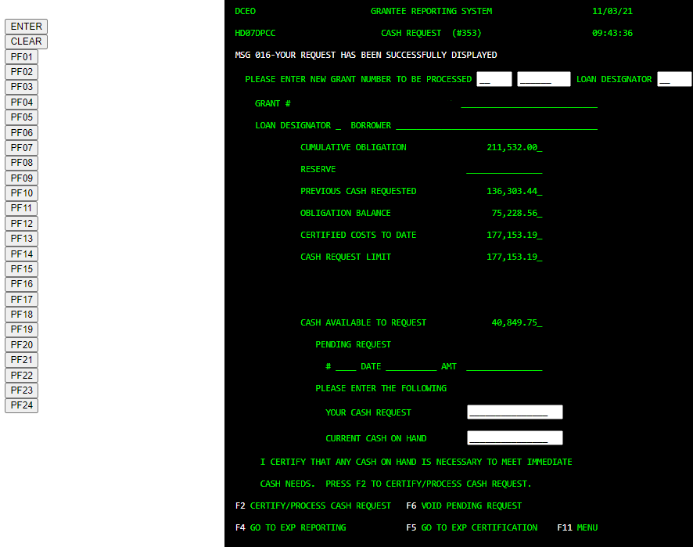
Cash Request #353
Verify there are funds available to request on the “cash available to request” field
Enter the amount of cash to be requested on the line titled “your cash request”
To certify your cash request, click the <PF02> button
To Void a Cash Request:
If you entered a request incorrectly and need to void it, it must still be in a pending status
To void a pending request, click <PF06> button
If the request is not in a pending status, you will need to contact Josh Koons at 217-622-7064
Note that a cash request transaction needs to be processed before grantees are able to enter a new request

Slide 25
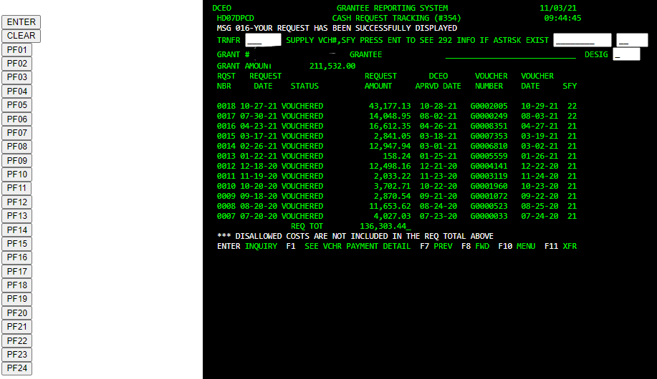
Cash Request Tracking #354
Type the grant number and click <Enter> button to inquire on cash requests for your grant
If there are more requests than can fit on a single screen, click the <PF08> button to scroll to the next screen
To see the warrant information from the Comptroller’s Office, click the <PF01> button to see this information. The information will only populate when a warrant has been issued. The system updates overnight.

Slide 26
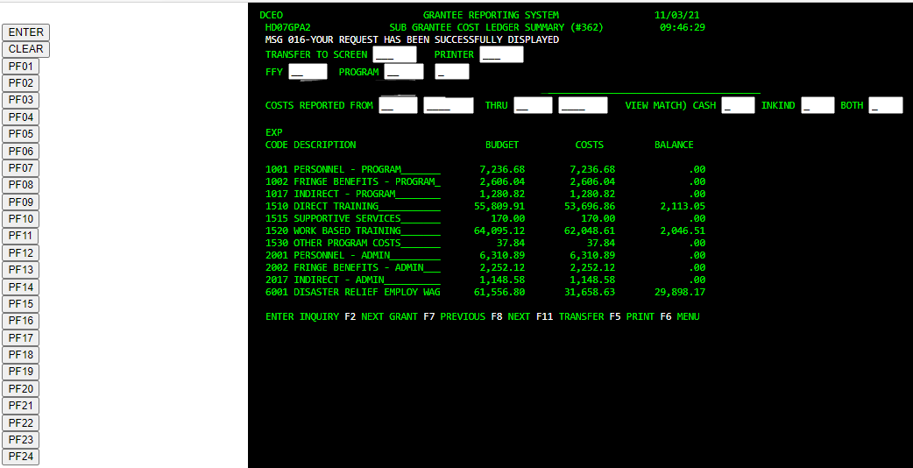
Sub Grantee Cost Ledger Summary #362
This screen ill provide you with information about the entire grant budget, expenditures reported, and balance of the grant
Enter the grant number and click the <Enter> button
To inquire on a specific period of time or specific ending date, enter data in the Costs Reported From and Thru field to narrow your search

Slide 27
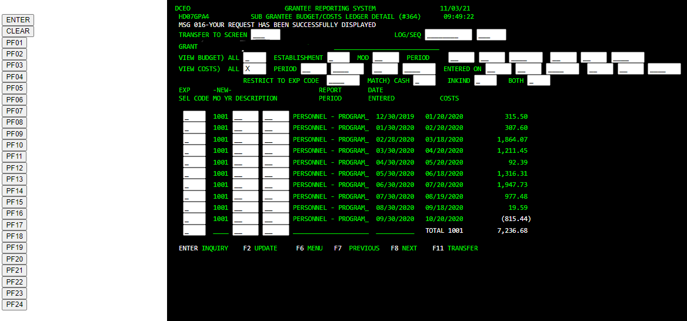
Sub Grantee Budget/Cost Ledger Detail #364
Enter your grant number in the field provided
Put an “X” in the View Costs All field
Click the <Enter> button
The system will provide information on all the entries made for each expenditure code on the grant. It will show the report period and the date the entries were made.

Slide 28
Direct Deposit (EFT)
Grantees that wish to receive payments via Electronic Funds Transfer (EFT) rather than a paper check should contact Illinois Comptroller’s Office at 217-557-0930 to requests for EFT payments.

Slide 29
Questions / For More Information
Joshua Koons
IL Department of Commerce and Economic Opportunity
Office of Employment and Training
Email: joshua.koons2@illinois.gov
Work #: 217-622-7064

